Slide 1
FCSS 101
FCSSAA Conference
November 17, 2022
Courtney Rippin Kaufman, Director, Community Preventive Initiatives
Mellissa Kraft, Executive Director, FCSSAA

Slide 2
Agenda
What is FCSS?
Program History and Mandate
FCSS Accountability Framework
Prevention Priorities and Strategies
How FCSS Works
Governance Structure
Role of the FCSSAA
Program Administration
Outcomes Model
Program Objective and Key Performance Measures
Eligible Programs and Services

Slide 3
What is FCSS?
Program History and Mandate

Slide 4
FCSS History and Mandate
Program started in 1966
80/20 Partnership
Voluntary Participation
FCSS Act and Regulation
Mandate and Requirements
Responsibilities and funding parameters
Emphasis on Prevention
Focus on Volunteerism

Slide 5
FCSS Accountability Framework
Common definition of prevention
Provincial prevention priorities and strategies
Clear governance structure
Streamlined outcomes model and Key Performance Measures

Slide 6
Prevention is a proactive process that strengthens the protective factors of individuals, families and communities to promote well-being, reduce vulnerabilities, enhance quality of life and empowers them to meet the challenges of life.

Slide 7
Prevention
Primary √
Secondary √
Tertiary
Address root causes of social issues
Address issues at early stage
Address immediate needs

Slide 8
Provincial Prevention Priorities
Homelessness and housing insecurity;
Mental health and addictions;
Employment;
Family and sexual violence and;
Aging well in community

Slide 9
Provincial Prevention Strategies
Promote and encourage active engagement in the community;
Foster a sense of belonging;
Promote social inclusion;
Develop and maintain healthy relationships;
Enhance access to social supports; and
Develop and strengthen skills that build resilience.

Slide 10
Governance Structure

Slide 11
Governance Structure
 | Program Advisory Team | Steering Committee
Purpose | Connect GoA FCSS program staff, FCSSAA, and Local FCSS Programs at the operational level to support FCSS Program accountability. | Formally connects and fosters a positive working relationship between the GoA and external FCSS stakeholders.
Membership | Civil Society and Community Initiatives Executive Director FCSSAA Executive Director FCSS Directors Network members GoA FCSS Program Staff FCSSAA Program Staff | Assistant Deputy Ministers (representing cross ministry partners) FCSSAA Board President FCSSAA Executive Director Alberta Municipalities Rural Municipalities of Alberta Metis Settlement General Council FCSS Directors’ Network representatives
Functions | Operational focus with work plan including: Developing and maintaining training material program guides, and program policies Identify operational issues and trends | Provides strategic oversight on matters including: Implementation of the framework Provincial level trends and emerging needs Opportunities for continuous improvement

Slide 12
The FCSSAA
Working Together

Slide 13
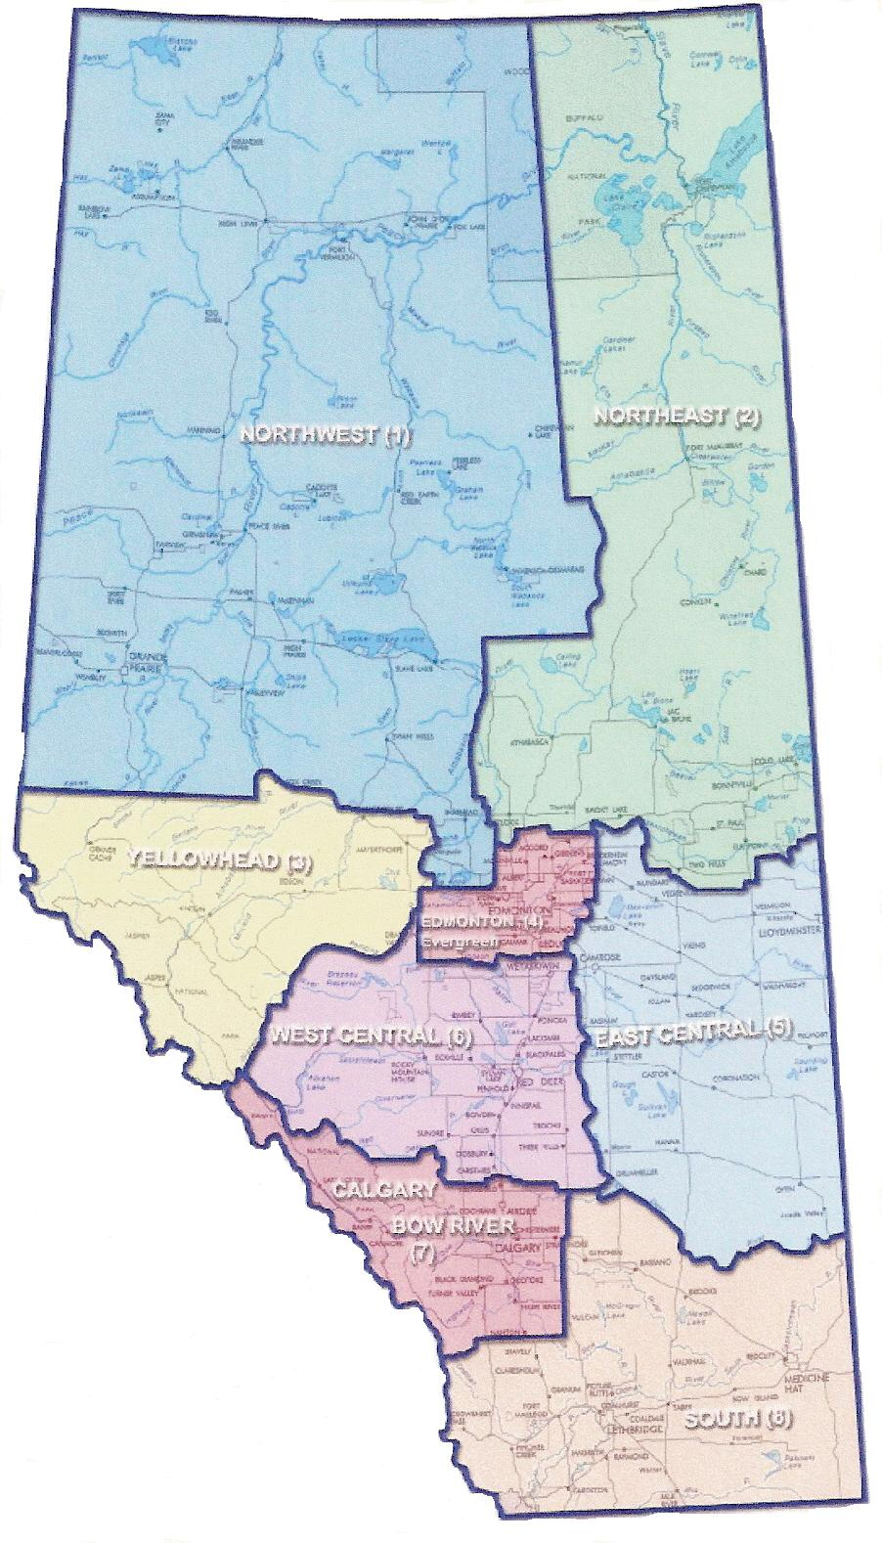
FCSS in Alberta
308 Municipalities and 8 Metis Settlements, organized into 210 local programs (Oct 1, 2022)
Over 98% of the population resides in communities with FCSS programs
8 FCSS regions in the province

Slide 14
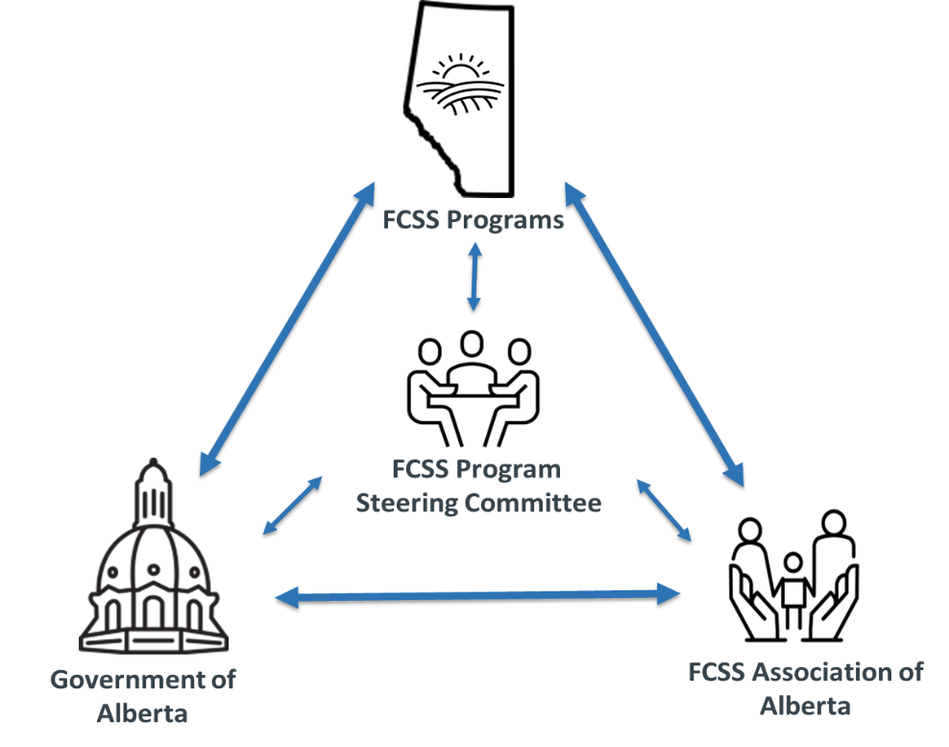
How FCSS Bodies Relate

Slide 15
FCSS Association of Alberta
Representatives from FCSS regions and the Director’s Network Committee make up the board
Strong voice on behalf of FCSS programs, advocating to government and non-government organizations on issues that impact FCSS
Works closely with the ministry; solid relationship with other ministries and non-government organizations related to FCSS
Annual conference in November and regular learning opportunities
Regional meetings occur in the spring

Slide 16
FCSS Administration
Program Structure and Municipal Responsibilities

Slide 17
Administration
Structure
Single Program
Multi Municipality
Grant Transfers
FCSS Department
Community Services Department
Direct Municipal Management
Society/Non-Profit

Slide 18
External Grants
Direct Delivery
services are provided by FCSS program staff or service providers under contract
FCSS funds granted to local organizations and groups to deliver services or projects - “FCSS funded agencies”
can be ongoing grants or one-time projects
must meet FCSS eligibility guidelines

Slide 19
Municipal Roles & Responsibilities
Responsibilities:
Develop stronger communities
Promote public participation
Facilitate and promote volunteerism
Use resources efficiently
Coordinate and cooperate with allied service agencies
Roles:
Municipal Council
Advisory Board/Committee
FCSS Program Director

Slide 20
Program Management
Community needs assessment
Plan programs and services
Outcomes monitoring
Program evaluation
Annual reporting
Promote the program and share success stories

Slide 21
Provincial Roles & Responsibilities
Coordinate program governance
Establish provincial prevention priorities and strategies
Ensure accountability
Complete program reviews
Interpret legislation
Develop policies
Provincial level reporting

Slide 22
FCSS Outcomes Model
Program Objectives & Key Performance Measures

Slide 23
Program Objectives and Outcomes
FCSS programming:
Increases the protective factors of individuals, families and communities related to provincial prevention priorities.
Strategically connects Albertans to address provincial prevention priorities.
Reflects community demographics and needs.
Is accessible, appropriate and designed to serve Albertans across their lifespan.
Fosters connectivity in participating communities

Slide 24
Key Performance Measures
Program Outcomes (streamlined list of provincial outcome measures)
Local FCSS Programs that completed a needs assessment
Number of program participants
Number of referrals made
Percentage of participants satisfied with FCSS programs and services
Percentage of participants reporting FCSS programs and services were easy to access
Number of partnerships
Number of volunteers and volunteer hours

Slide 25
Eligible Programs and Services

Slide 26
Program Requirements and Eligibility
Must be preventive, enhance the well-being of individuals and families, and contribute to one or more of the following:
Help people develop independence, strengthen coping skills, and become more resilient to crisis;
Help people develop an awareness of social needs;
Help people develop interpersonal and group skills that enhance relationships;
Help people and communities assume responsibility for decisions and actions that affect them; and
Support people to be active participants in their community

Slide 27
Eligible Programs
Projects that assist communities to identify their social needs and develop responses to meet those needs;
Programs that promote, encourage and support volunteer work in the community;
Services that inform the public of available services;
Programs that support skill development so people can function more effectively within their environment;
Programs to support seniors to remain in their homes; and
Programs promote the social development of children and their families.

Slide 28
Ineligible Services
Services must not:
Be primarily recreational or leisure time pursuits
Be primarily rehabilitative in nature
Duplicate services provided by a government or government agency
Offer direct assistance*
Prohibited costs:
Capital expenses (land, buildings, building renovations, vehicles)
Those not directly related to FCSS programs/services
Municipal taxes or levies
Payments to board members other than expense reimbursement

Slide 29
Eligibility Assessment
Question |  | Answer
Is the service or project preventive in nature? |  | Yes
Does it enhance the social well-being of individuals or families? |  | Yes
Does it address a community need? |  | Yes
Does it align with one or more prevention strategies? |  | Yes
Does it address one or more of the prevention priorities? |  | Yes
Is it: Primarily recreational? Primarily rehabilitative? | Does it: Duplicate a program or service? Provide direct assistance | No
Does it comply with allowable municipal costs? |  | Yes

Slide 30
Questions?

