Slide 1
Understanding Electricity and Natural Gas Utilities in Alberta
Utilities Consumer Advocate
October 2023

Slide 2
What is the Utilities Consumer Advocate?
Residential
Small Business
Farm
Established in October 2003
Ministry of Affordability & Utilities
Represents interests of Alberta’s electricity and natural gas consumers
Notes:
Who We Are
Established in October 2003 by Service Alberta
Offices in Edmonton (Mediation team, Consumer Education team) and Calgary (Market Policy team, Regulatory team)
Represent interests of residential, farm and small business utilities consumers to regulators and industry
By offering information on how to select your services and how to understand what those line items on your bill mean, we’re proud to be an unbiased resource Albertans can trust..
Our mission is to make you an informed energy consumer.

Slide 3
Advocacy
Shareholder Interests
Ratepayer Interests
Utility companies
Public Interest
Utilities companies apply for rates and infrastructure approvals from the AUC to provide reliable service to customers and a reasonable return to their shareholders.
Alberta Utilities Commission
The UCA intervenes in AUC proceedings to ensure residential, small business, and farm customers receive reliable services at reasonable prices.
The AUC regulates the utilities sector, and natural gas and electricity markets to protect social, economic and environmental interests of Alberta where competitive market forces do not.
Notes:
UCA role in Advocacy (Electricity and Natural Gas)
To explain why we’re needed in regulatory proceedings to represent the interest of consumers, we like to use the see-saw analogy.
Electricity and natural gas utilities are on one side of the see-saw, representing their interests. On the other side of the see-saw, are the ratepayers and the Utilities Consumer Advocate representing their interests. The Alberta Utilities Commission is NOT on the see-saw – it’s the fulcrum (balancing point), balancing the interests of the two parties on each side.

Slide 4
How Alberta’s Utilities Market Works
Notes:
How Alberta’s Utilities Market Works
Alberta’s competitive utility market is unique in Canada, including how heat and power are created, delivery and sold to consumers.

Slide 5
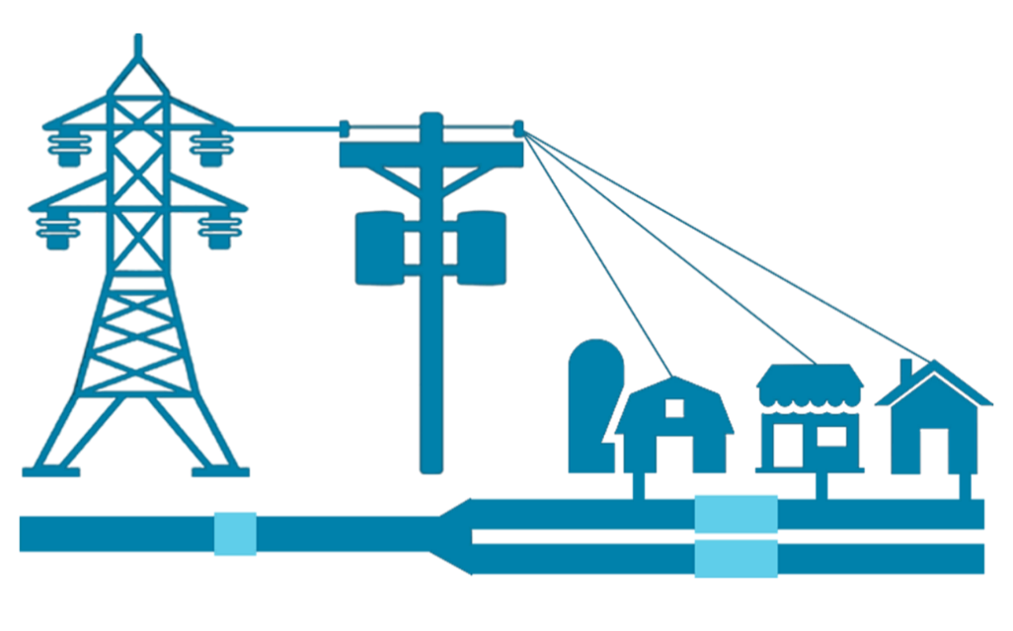
How Electricity and Natural Gas are Delivered
Regulated Monopoly Utilities
Generation & Production
Transmission
Distribution
Retailers
Consumers
Where electricity and natural gas are made
Moves energy gets to cities and towns
Delivers energy to your residence, business or farm
Sells energy to consumers
Homes, businesses, and farms
Notes:
Utilities Delivery System
Transmission: Moving electricity or natural gas over long distances from the generating source to your local service area. Think of the big, silver electricity towers (or high pressure gas pipelines)
Distribution: Moving electricity or natural gas within your area, usually within your city or town. Think of the wooden power poles (or underground electricity lines and low-pressure gas pipelines.
Distribution (Fortis/ATCO Gas)
Some costs are daily or fixed charges that will remain the same regardless of usage.
Why? The infrastructure is high cost that is recovered over a long time
That cost of building and maintaining the equipment remains regardless of whether it is used or not.
Compare to phone – fixed monthly charges even it sits in a drawer
Compare to mortgage – continue to pay even you’re away for half the year.
Others are based on usage and will fluctuate as usage increases or decreases.
Transmission, Distribution, Delivery = Maintenance, emergency outages, new infrastructure and equipment
Municipal Franchise Fee, Local Access Fee = Utilities pay these fees to the municipalities in leiu of property tax for land access for facility placement
Rate Riders = balancing pool credit, adjustments made for over/under collection in previous months or years.

Slide 6
Understanding Utility Bills
Notes:
Understanding utility bills - overview
Many people don't understand their bills or the terms and conditions. For example, some contracts may have a clause to automatically renew the agreement unless the consumer explicitly says otherwise.
While Automatic Payment Withdrawals from a credit card or bank are convenient, you should always review your invoices. Even if the amount looks reasonable, there is always the chance of an error.

Slide 7
Electricity Breakdown

Slide 8
Natural Gas Breakdown
Notes:
Alberta's gas prices are determined by supply and demand and are influenced by market conditions and prices throughout Alberta and North America. Some factors affecting natural gas prices include:
Weather conditions
Storage inventory levels
Gas drilling levels and production
Natural gas imports (from the United States)
Economic conditions

Slide 9
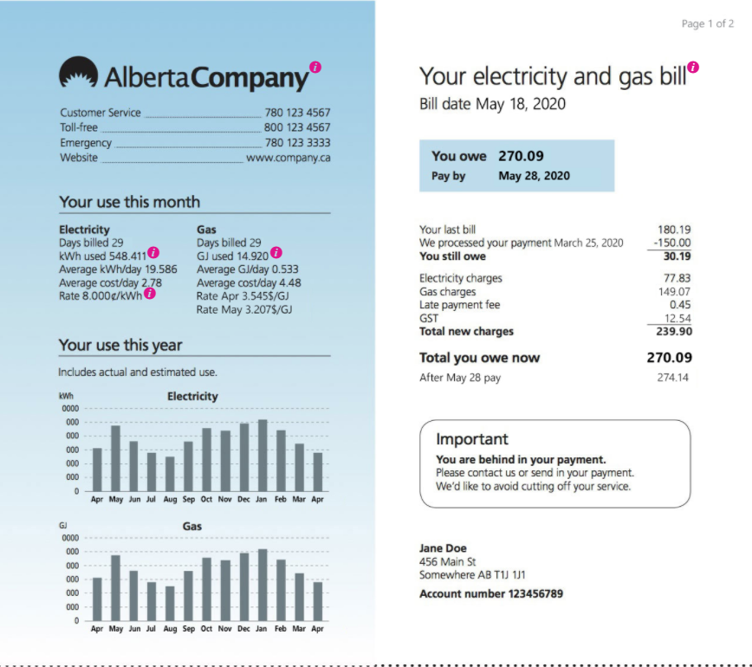
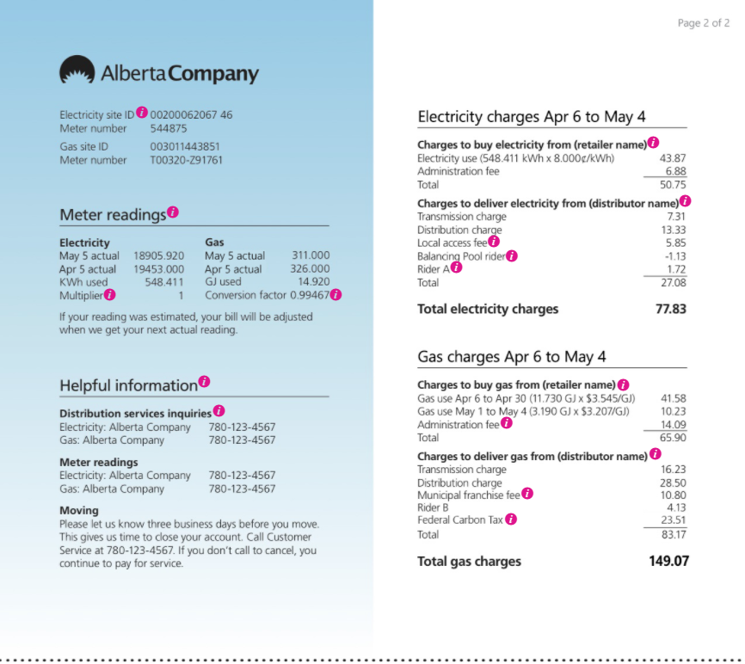
Sample Bill
Notes:
Understanding your bill – detailed breakdown page 1
Many people don't look at their bills or the terms and conditions. For example, some contracts may have an clause to automatically renew the agreement unless the consumer explicitly says otherwise.
While Automatic Payment Withdrawals from a credit card or bank are convenient, you should always review your invoices. Even if the amount looks reasonable, there is always the chance of an error.
What’s on your bill?
The first page provides you with a general overview of:
Your total costs
Your utilities charges
Your rates
Your monthly use averages

Slide 10
Understanding Utility Bills
Terms on your electricity and natural gas bills
Retail Charges | Energy Use | How much heat and/or power you use each month.
 | Administration Fee | Cost for billing and customer service/call centre.
Delivery Charges | Transmission | High volume at high speed (e.g. highway).
 | Distribution | Local delivery to homes and businesses (e.g. city roads).
 | Local Access Fees | Cities/towns charge to utilities to use land for power lines and infrastructure.
 | Rate Riders | Temporary costs or credits when there is a difference between actual and approved costs for utility.
Other Charges | Federal Carbon Charge | Federal price ($3.33/GJ) on CO2 emission on natural gas bills. Rate changes to $4.10/GJ for April 1, 2024 – March 2025. Quarterly rebates issued every January 15, April 15, July 15, and October 15.
 | GST | 5% Goods and Services Tax applicable to subtotal of retail, delivery and other charges.
Notes:
Fixed Costs: set costs that don’t change based on your usage
Cost of building and upgrading distribution infrastructure
Charged on your bill as a daily rate or monthly rate
Variable Costs: can change based on usage
Operating and maintaining the distribution systems
Connecting/disconnecting customers
Meter reading
Charged on your bill as a per kWh or GJ rate

Slide 11
Paying Utility Bills
Plan for seasonal differences
Consider setting up a budget plan with your retailer
Look at Authorized Payment Plans
Notes:
Plan for seasonal differences
Electricity, natural gas and water bills fluctuate every month
Seasons and weather are the biggest factors
Winter’s cold weather causes higher natural gas bills to heat homes
Summer’s warm weather leads to higher electricity bills (e.g. fans, air conditioners, etc.)
Water usage spikes in the spring (watering lawns) and September (returning home from vacations)
Consider a Budget Payment Plan
Many retailers (regulated rate providers and competitive rate retailers) offer equalized payment plans
Costs are averaged over 12 months and consumers are billed an equal amount each month
Typically has 11 months at the same rate and one month adjusted to true up the total for the year
Authorized Payment Plans
Option to set up your utilities bill to be automatically withdrawn from your bank account each month
Some retailers require consumers to sign up for Authorized Payment Plans to receive service

Slide 12
Shopping for Utilities
Notes:
UCA website
Our website, ucahelps.alberta.ca, offers a number of great tools for electricity, natural gas and water consumers in the province.
Homepage
Our goal is to create a welcoming and user-friendly homepage to help consumers find the information they’re looking for.
The main image scrolls through the most common information requests
The site is easy to navigate, with options for residential, farm and small business consumers

Slide 13
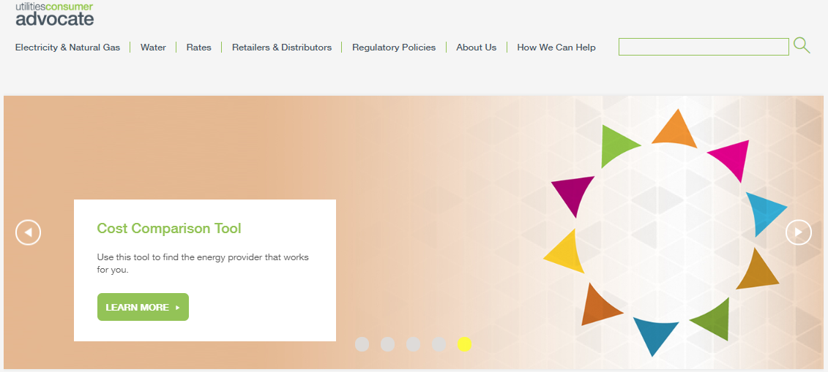
Cost Comparison Tool
ucahelps.alberta.ca/cost-comparison-tool.aspx
Notes:
Cost Comparison Tool
With so many options, we developed a Cost Comparison Tool to help consumers compare rates and make an informed choice on how they purchase their energy.
This tool allows you to look at different rates and retailer products based on where you live and your actual or estimated consumption. Depending on what you choose, the end result is delivered costs. After this presentation, please visit the Cost Comparison Tool on our website. Just enter your postal code and check out the options available in your area.

Slide 14
Regulated Rate Providers
 | Within Calgary | Within Edmonton
Electricity
Natural Gas
Notes:
Regulated rate providers
In most regions of the province, the regulated rate providers for electricity and natural gas operate as the default providers in each municipality.
Can be offered by a company or municipality
Regulated rates are approved by the AUC and vary monthly
Some rural clients receive their utilities from a Gas Co-op and/or Rural Electrification Association
In these areas, clients don’t have a choice of retailers
Co-ops and REAs fall under Alberta Agriculture and Forestry’s mandate

Slide 15
Competitive Retailers
Notes:
Competitive retailers
Alberta’s unique deregulated utilities market allows consumers the choice of who they buy their electricity and natural gas from.
How many utilities retail options do you think we have to choose from?
There are more than 50 retail options with multiple offers and product designs
What’s available?
Consumers can choose electricity, natural gas or bundled options
Retailers offer choice of fixed, variable or combined rates
Consumers can pick the contract term length that best suits their needs
1-5 year options available
Companies may offer incentives in exchange for signing a contract
Cash back programs
Loyalty program points
Smart thermostats
Prepaid credit/gift cards
Competitive companies offer a range of products and the prices can be fixed or variable, these companies are not subject to AUC regulation but must comply with the Fair Trading Act:
Sales agent Code of Conduct (high pressure sales, misrepresentation)
Contract content (disclosure statements, start and end date)

Slide 16
Regulated vs. Competitive Rates
Regulated Rate Option | Competitive Rate Options
One provider in your area | Choice of retailers
Rate set each month | Choice of fixed and variable rate
Month-to-month | 1-,3-,5-year contract options
No credit check | May require a credit check
May require deposit | Some companies offer bundled billing
Separate bills for heat and power | Potential exit fees
No exit fees | May offer incentives
 | Could be additional fees (membership)
Notes:
Comparing Regulated and Competitive Rates
Alberta has a unique system that allows consumers to choose how they receive their electricity and natural gas utilities. Here’s a quick look at the differences between these two options.
Regulated rate
Pros
Default provider has an ongoing obligation to serve consumers in the service area
Immediate start date
No term means you can stay with it as long as you like
Reflects current market rate – you always pay the going rates
No credit check – as the default option, the regulated providers won’t ask to do a credit check
Cons
Separate billing – different bills for each service
Rate fluctuations – market rates can change from month to month, sometimes drastically
May require a deposit – if you don’t have an existing relationship with a provider, they will ask for a deposit.
Competitive rate retailers
Pros
Choice between fixed and variable rates – choose the option that best fits your preferences
One bundled bill – consumers can purchase their electricity and natural gas from one retailer with only one monthly bill
May offer incentives and other options – Many retailers will offer benefits to entice consumers to sign a contract over a set amount of time.
Choice of retailer – if you have a bad experience with a company, you have the option to switch to another provider.
Cons
Requires a credit check – Retailers want proof consumers have a track record of paying their bills on time.
May have exit fees for ending a contract –
Read the fine print. If you agree to a contract with exit fees, it can be costly to switch providers.
How to Choose
There are benefits to either option, and it ultimately comes down to consumer preferences.
The Cost Comparison Tool on our website is very useful for making an informed decision that fits your needs.
Other considerations
Some providers may also offer options like budget billing, where your bill is the same every month (11 months of the year, with the 12 month allowing for any necessary adjustments).

Slide 17
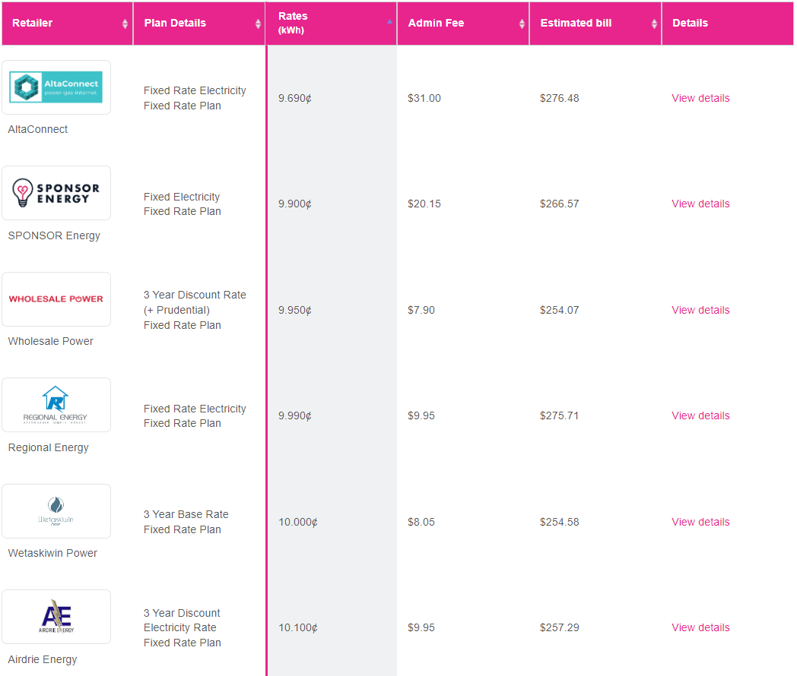
Cost Comparison Tool – Electricity Rates
Company A
Company B
Company C
Company D
Company E
Company F
Notes:
Comparing rates
Once you input your location details, the Cost Comparison Tool will show an overview of all the available options offered by retailers in your area.
In this example, we’re looking at bundled plans that include electricity and natural gas utilities. From here we can look at the details of individual plans or compare three plans to see how the costs breakdown.
Note: Usage in this example is 649 kWh and 14.23 GJ for the month of November.

Slide 18
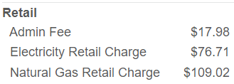
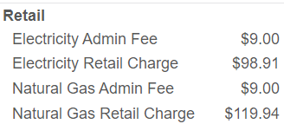
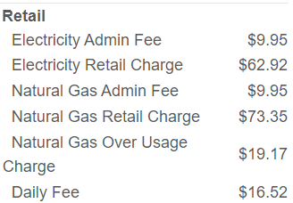
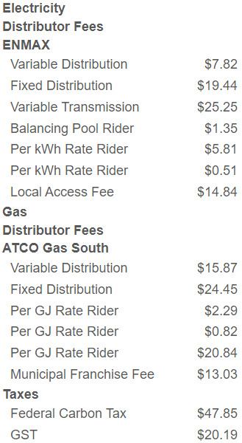
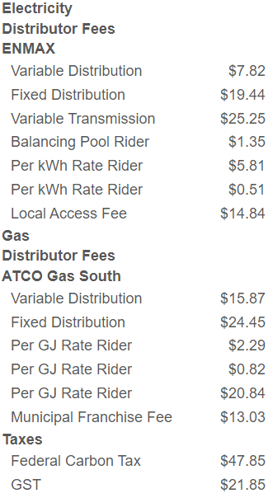
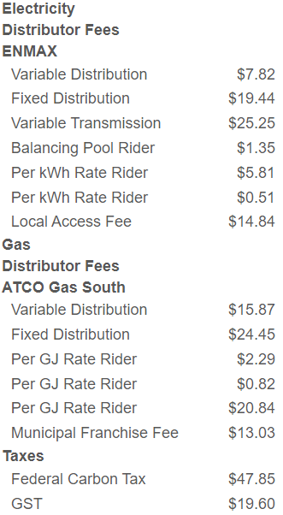
Cost Comparison Tool – Compare Plans
Company A
Company B
Company C
Notes:
Comparing plans – plan pricing
When comparing Plan Pricing, you will see the differences between plans:
Administration fees
Retail charges (usage x rate)
Things to Note
Delivery changes for all three options will be the same
Usage in this example is 649 kWh and 14.23 GJ for the month of November.

Slide 19
Saving Money on Utilities
Notes:
Saving Money on Utilities
While rates are out of your control, there are steps you can take to save money on your utility bills by reducing your usage.

Slide 20
Reducing your usage
Colder months
Electrical efficiency
Heating and cooling efficiency
Water efficiency
Notes:
Colder months
Use the suns energy! Open your shades to the sunny side of your house during the day and close them later in the day
Use an automatic car timer – your block heater only needs to be plugged in for three hours before you must go
Close doors and vents in unused rooms, closets or bays. Just make sure it’s warm enough so there isn’t freezing!
Electrical Efficiency
Use smart power bars
Wash laundry in cold water
Unplug chargers that aren’t in use
Heating and cooling efficiency:
Use a smart thermostat
Find and seal leaks
Schedule regular maintenance
Water efficiency
Take shorter showers
Turn water off while shaving or brushing your teeth
Fix leaks as soon as possible
For more information, check out our website.

Slide 21
Winter Utilities Reconnection Program
Notes:
UCA website
Our website, ucahelps.alberta.ca, offers a number of great tools for electricity, natural gas and water consumers in the province.
Homepage
Our goal is to create a welcoming and user-friendly homepage to help consumers find the information they’re looking for.
The main image scrolls through the most common information requests
The site is easy to navigate, with options for residential, farm and small business consumers

Slide 22
Winter Utilities Reconnection Program
Winter Rules
electricity October 15 – April 15;
natural gas November 1 – April 15
We can help!
Notes:
Winter Rules
In Alberta, electricity services can not be turned off from October 15 – April 15; while natural gas cannot be shut off from November 1 – April 15.
The Utilities Consumer Advocate (UCA), in partnership with the Alberta Utilities Commission (AUC), utility retailers and distributors, and other government agencies, such as Alberta Works and AISH, contacts customers with disconnected utilities to help get them reconnected before the cold weather hits.
A limiter may be installed on the property instead
If your account remains unpaid after April 15, services may be disconnected
We can help!
While the UCA is unable to provide financial assistance, we may be able to mediate payment arrangements with your retailer or provide referrals to agencies that can help
The UCA will begin reaching out to customers at the beginning of November who may have utilities disconnected
If your services are disconnected, we urge you to call one of our mediation officers

Slide 23
Electricity and Natural Gas Trends

Slide 24
Average Electricity Regulated Rates (¢/kWh)
 | 2020 | 2021 | 2022 | 2023
January | 7.431 | 7.981 | 15.239 | 13.500* (28.369)
February | 7.837 | 8.763 | 15.248 | 13.500* (31.914)
March | 6.570 | 7.335 | 10.487 | 13.500* (20.054)
April | 5.564 | 8.825 | 10.407 | 15.775 (2.491)
May | 5.529 | 7.504 | 10.070 | 16.563 (2.598)
June | 5.367 | 6.782 | 11.493 | 18.468 (2.666)
July | 6.163 | 10.071 | 14.486 | 27.499 (2.576)
August | 6.222 | 12.024 | 15.702 | 32.270 (2.597)
September | 7.167 | 10.518 | 15.785 | 27.628 (2.560)
October | 5.938 | 10.384 | 18.722 | 19.631 (2.338)
November | 5.758 | 10.669 | 17.734
December | 6.777 | 11.972 | 22.990
Average | 6.360 | 9.402 | 14.864 | 19.833* (23.817)
*Government of Alberta implemented a 13.5¢/kWh regulated rate ceiling in January-March 2023.

Slide 25
Average Natural Gas Default Rates ($/GJ)
 | 2020 | 2021 | 2022 | 2023
January | 2.259 | 2.784 | 3.645 | 6.426
February | 2.242 | 2.766 | 5.050 | 3.446
March | 1.660 | 4.102 | 4.939 | 2.537
April | 2.140 | 2.603 | 4.594 | 3.569
May | 2.564 | 3.293 | 7.039 | 2.249
June | 2.381 | 3.352 | 8.699 | 3.363
July | 1.530 | 3.028 | 9.094 | 2.447
August | 1.359 | 3.328 | 6.679 | 3.215
September | 2.492 | 3.454 | 7.212 | 2.849
October | 2.251 | 4.079 | 5.113 | 2.495
November | 3.277 | 5.328 | 5.507
December | 2.705 | 4.936 | 6.167
Average: | 2.238 | 3.588 | 6.144 | 3.260
Notes:
Natural gas is up significantly since July (typically a low usage month); and $2.103/GJ (64%) higher than this time last year.

Slide 26
Comparing Rate Types - Usage
2022 Averages | Regulated Rate | Fixed Rate Plan | Variable Rate Plan
Electricity Usage (570 kWh) | $83.85 (14.711¢/kWh) | $46.04 (8.077¢/kWh) | $106.98 (18.769¢/kWh)
Natural Gas (10.6 GJ) | $65.17 ($6.144/GJ) | $57.52 ($5.423/GJ) | $71.28 ($6.720/GJ)
September 2023 | Regulated Rate | Fixed Rate Plan | Variable Rate Plan
Electricity Usage (510 kWh) | $137.89 (27.628¢/kWh) | $54.61 (10.941¢/kWh) | $76.06 (15.240¢/kWh)
Natural Gas (5.1 GJ) | $19.91 ($2.849/GJ) | $24.91 ($4.884/GJ) | $20.67 ($4.052/GJ)
Note: Costs are for electricity and natural gas usage only, table does not include delivery and administration charges
Notes:
variable (floating) rate (wholesale price + transaction fee)

Slide 27
Summary
Consumer Knowledge = Consumer Power
The more you know, the easier it is to make informed decisions
Learn and understand the products and services you consume
Research resources available to you
Notes:
Consumer knowledge = consumer power
Education and information
Being an informed consumer goes beyond knowing about products and services.
We all have a right to know what practices are and aren’t allowed.
e.g. Door-to-door energy contract sales ban
Resources
Retailers/energy companies
Utilities Consumer Advocate
Alberta Federation of Rural Electrification Association
Federation of Gas Co-ops

Slide 28
Contact Us
facebook.com/ucahelps
ucahelps.alberta.ca
ucahelps@gov.ab.ca
310-4UCA (4822)
Notes:
Thank you
Contact the UCA
Facebook
Website
Email
Phone

