Slide 1
FCSS Accountability Framework
Reporting Training
Notes:
Hello and welcome.
Thank you for joining us for this recorded training session for the FCSS Accountability Framework reporting.

Slide 2





Hello! Welcome to Training.
More Information
Training Package
Page X
This training will have 10 modules and will take approximately 4 hours to review.
Materials and handouts will be referenced throughout training.
There are activities sprinkled throughout the training to help reinforce knowledge.
Notes:
This training is organized into a series of 10 modules.
Each module focuses on a specific topic and includes key information, examples, and opportunities to reflect on how the content applies to your work.
You will notice a “training resource” icon in the top right corner of your screen throughout the modules.
This icon will point you to relevant materials in the associated training package.
We have also included a few interactive activities to help reinforce key concepts.

Slide 3

Training at-a Glance
Module 1
Context Setting
Module 2
The FCSS Policy Landscape & Reporting Updates
Module 3
Activity Categorization & Prevention Continuum
Module 4
Prevention Strategies
Module 5
Provincial Prevention Priorities
Applied Learning Exercise
Aligning Programs to Provincial Prevention Priorities
Module 6
Counting
Module 7
Choosing Categories
Module 8
Surveying
Module 9
Impact Narratives
Module 10
Conclusions & Next Steps
Notes:
As mentioned, the training is broken down into a series of modules.
This format is meant to make the content easier to digest and give you the flexibility to move through it in a way that works best for you.
We will start with five modules.
Mid-way through the modules, you can apply what you have learned so far through an applied learning exercise; a brief assignment that should take no more than 15 minutes.
This applied learning exercise is located on pages 39 and 40 of your training package.
After completing the exercise, you will continue with five additional modules that build on the earlier content.
We recognize that this new reporting approach may feel like a lot at first; and that is completely normal.
Change takes time, and we do not expect everything to click right away.
The Government of Alberta FCSS team is available to support you throughout this process.
Our goal is to make this transition as manageable and meaningful as possible.

Slide 4
Learning Outcomes
More Information
Training Package
Page 3
By the end of this training, you will be able to:
Describe the new changes to the reporting process in alignment with the FCSS Accountability Framework and associated timelines
Identify how to categorize your program activities
Identify how to categorize the levels of prevention and how your programs align with these levels
Describe the six (6) prevention strategies and how your programs align with these strategies
Describe the 5 provincial prevention priorities and how your programs align with these priorities
Understand how to use survey questions
Describe how to report volunteers, community partnerships, participant interactions, attendees and referral interactions
Describe how to report age groups and community groups
Describe how you can share an impact narrative
Know where to find further tools and resources
Notes:
Before we get started, let us have a look at some of the learning objectives for this training.
These learning objectives are also located on page 3 of your training package.
At first glance, it might seem like there is a lot to get through.
While the new reporting template does introduce some changes, not everything is brand new.
As we go through the content, you will notice that a lot of the reporting has remained similar.
And where there are changes, many of them are designed to make things simpler and clearer.
This training is designed as an introduction to the concepts and approaches in the new reporting requirements.
The Government of Alberta FCSS team will be working with the FCSS association of Alberta to develop further resources and supports related to topics included as part of this training.

Slide 5
Module 1
Context Setting
Notes:
Welcome to module 1.
Before getting into the new reporting requirements, we will take some time to learn about the accountabilities within the FCSS program, and highlight some key milestones associated with the new reporting framework.

Slide 6






Navigating Accountability & Reporting
This training is focused on provincial reporting requirements for FCSS programming
FCSS programming is a partnership between the Government of Alberta and municipalities.
Provincial reporting is just one piece of the bigger reporting and accountability puzzle.
Notes:
This training is related to FCSS reporting requirements. However, we also know that you have other reporting accountabilities, like to your own boards or municipal councils.
Also, while programs are not accountable to the FCSSAA, the association plays an important role in highlighting the collective efforts of all FCSS programs across the province through the interactive impact tool.
We hope that some of the information that is collected for provincial reporting requirements can help support the reporting that you have in other spaces.
The new reporting framework is for keeping track of FCSS-only activities, which applies to both direct and indirect service delivery.
This means any agency or organization that is delivering programming through FCSS funding will also need to report in accordance with the accountability framework.

Slide 7





Key Milestones and Timelines
Municipalities
May – August
2025
January
2026
January – December
2026
January – April
2027
Framework Training
Funding Agreements
Data Collection
Reporting Training
Annual Reporting
Government of Alberta FCSS Accountability Framework live training.
New three-year municipal grant cycle begins (2026 - 2028)
Programs will monitor activities and collect data in accordance with the accountability framework.
Updates to FCSS Portal reporting tool and subsequent training.
Programs report on 2026 activities in FCSS Portal using the new framework indicators.
Notes:
Here are some of the key milestones and timelines associated with reporting changes.
Earlier in spring and summer 2025, we hosted a series of live training sessions to introduce the new reporting requirements.
As a follow up to those live sessions, these recorded modules are meant to support continuous learning.
This asynchronous format allows you to move through the material at your own pace and revisit any sections as needed.
The content mirrors what was covered in the live sessions, with a few updates and adaptations for self-guided learning.
In January 2026, the new three-year FCSS Funding Agreements will be signed.
For Metis Settlements, this will take place in April 2026.
Throughout 2026, you will want to begin tracking activities in alignment with the new reporting framework.
During that time, we will also be working on updates to the FCSS online system to support reporting.
Once these updates are complete, further training will be provided.
Then, in January 2027, municipal FCSS programs will begin reporting using the new framework and tools.
For Metis Settlements, this will begin in April 2027.

Slide 8


New Reporting Structure
Accountability, Planning and Alignment
Why We Report
Supports business planning and decision-making
Helps us track progress and learnings over time
Working Together
Our goal is for reporting requirements to compliment and support other accountabilities
Notes:
You may be asking yourself: Why are we changing the reporting approach? OR how will the province use this new information?
As you know, reporting plays a critical role in demonstrating accountability and communicating the value of FCSS.
This updated reporting format is intended to more clearly illustrate the scope and impact of FCSS work across Alberta.
By incorporating both qualitative and quantitative elements, we can better demonstrate the collective value of FCSS programs and services.
In addition to supporting transparency, the data you provide may inform business planning and decision-making.
With this enhanced approach, we will be better equipped to identify trends, respond to emerging needs, and plan for the future.
We recognize that you already manage multiple accountability requirements.
Our intent is not to add unnecessary burden, but to align where possible, so that the data collected for this framework can also support your other reporting obligations.

Slide 9
Module 2
FCSS Policy Landscape & Reporting Updates
Notes:
Welcome to Module 2
In this module, we will review the FCSS policy landscape and reporting updates.
As we were developing this training, we recognized the importance of discussing the FCSS policy landscape, which includes the FCSS Act, the FCSS Regulation and the FCSS Accountability Framework
All of these are linked on page 4 of your training package.
Since the Act and Regulation set the parameters for the FCSS program, and the accountability framework serves as the key foundation for the reporting process, we thought it would be helpful to give a quick refresher on these documents.

Slide 10

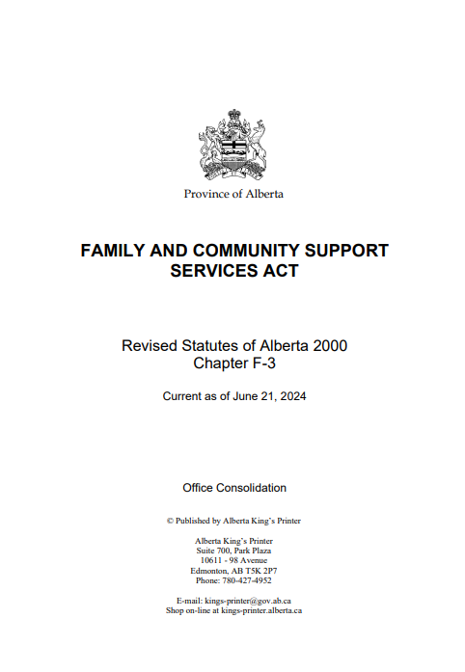
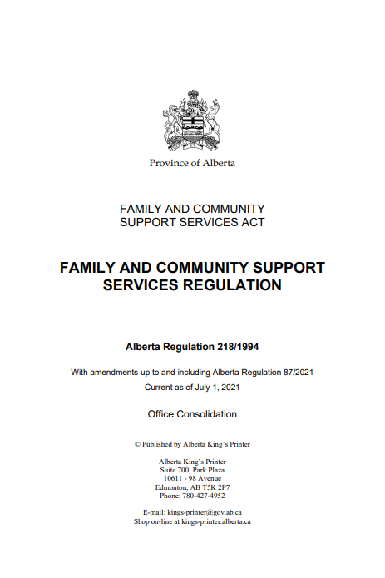
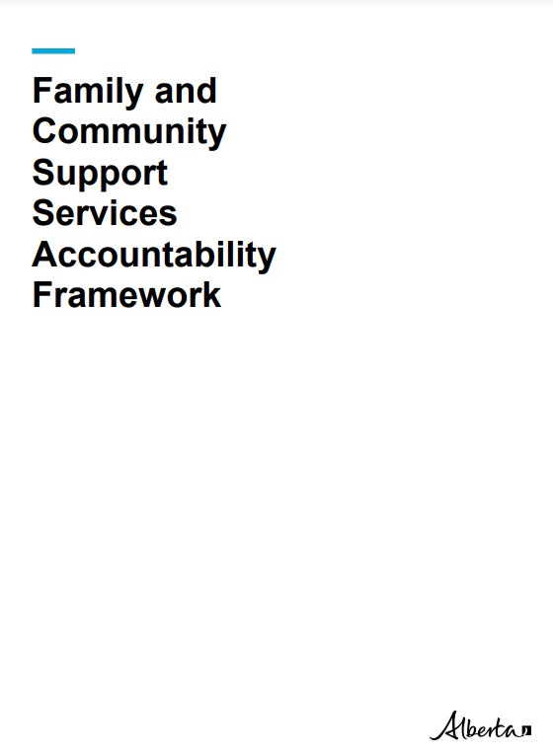
FCSS Policy Landscape
More Information
Training Package
Page 4
Notes:
To help explain how these three documents fit together, we will use a bit of an analogy.
We can envision these documents as a house, where each component symbolizes a distinct layer.
In this analogy, the Act serves as the framing and the foundation, providing the broad legal authority for the program to exist.
The Regulation functions as the drywall and flooring.
And the Accountability Framework encompasses the finer details, like fixtures and furnishings.
This structure is not unique to FCSS; as many government programs are similarly established.
Although it may seem more straightforward to consolidate all information into a single document, we cannot include everything within the Act, because like the foundation, it is very difficult and costly to change.
So, we incorporate operational issues and flexibility into regulations and policy, such as the Framework.

Slide 11

Family and Community Support Services Act
More Information
Training Package
Page 4
Provides the legal basis for the funding partnership between government and the municipality or Metis Settlement.
Governs the creation of funding agreements between the Minister and the municipality or Metis Settlement.
Outlines the requirement for an 80/20 split in funding.
Outlines the powers of municipalities to establish, administer and operate a FCSS program.
Notes:
Let us start with the FCSS Act…
As mentioned, this is the broadest and most overarching piece, providing the legal basis for the funding partnership, including the 80/20 funding split between the province and municipalities or Metis Settlements.

Slide 12
Family and Community Support Services Regulation
More Information
Training Package
Page 4
Outlines that FCSS programs must be preventative
Outlines the responsibility of municipalities and Metis Settlements in designing and developing preventive social services
Identifies the service requirements of the programs to be provided
Provides guidance on what costs are eligible expenses
Notes:
The FCSS Regulation provides more specific details on how the Act should be applied, including outlining what municipalities and Metis Settlements can and cannot do.
The FCSS Regulation also outlines the requirement related to the preventive nature of programming.

Slide 13
Family and Community Support Services Accountability Framework
More Information
Training Package
Page 4
1 common definition of prevention
5 key Provincial Prevention Priorities (social priorities)
6 prevention strategies
5 objectives, which each have immediate, intermediate, and long-term outcomes
13 Key Performance Measures (KPMs)
Notes:
Next, the Accountability Framework, which was first introduced in 2022.
It adds details and clarity around what FCSS programs can do within the context of the Regulation and how prevention is defined for the FCSS program.
It ensures consistency in FCSS programming by providing a common definition of prevention, supporting effective implementation, and providing a way to measure progress.
Annual reporting for 2026 onwards will be aligned with this framework.
This new reporting will incorporate:
5 Provincial Prevention Priorities
6 Prevention Strategies, and
5 objectives that will be assessed through…
13 Key Performance Measures
In the next few slides, we will review the main pieces of the Accountability Framework so you can get a feel for how it all connects.

Slide 14

FCSS Accountability Framework
A Common Definition of Prevention
More Information
Training Package
Page 22
“
Prevention is a proactive process that strengthens the protective factors of individuals, families and communities to promote well-being, reduce vulnerabilities, enhance quality of life, and empowers them to meet the challenges of life.
”
Primary
Root causes of social issues
Secondary
Issues at early stage
Tertiary
Immediate needs & direct support
In Scope
Notes:
Here you can see the common definition of prevention as defined in the framework.
Prevention is often understood as a continuum, where:
Primary prevention focuses on addressing the root causes of social issues, such as through awareness programs and strengthening connections among community organizations,
Secondary prevention targets risk factors at an early stage by implementing supports, and
Tertiary prevention, is concerned with addressing immediate needs through direct assistance.
Both primary and secondary prevention strategies are within scope of FCSS programming, and tertiary is not.

Slide 15





FCSS Accountability Framework
Provincial Prevention Priorities
More Information
Training Package
Page 12
Homelessness and Housing Insecurity
Mental Health and Addictions
Employment
Family and Sexual Violence
Aging Well in Community
Notes:
Let us discuss the 5 Provincial Prevention Priorities.
The prevention priorities are intended to reflect the key social issues facing Albertans - and the new reporting will be measuring how many FCSS activities address these various priorities.
These priorities will be reviewed every three years to make sure they remain current.
These priorities are further detailed on page 12 of your training package.

Slide 16
FCSS Accountability Framework
Prevention Strategies
More Information
Training Package
Page 13
Promote and encourage active engagement in community
Foster a sense of belonging
Promote
social inclusion
Things FCSS programs can do to enhance protective factors
Develop and maintain healthy relationships
Enhance access to social supports
Develop and strengthen skills that build resilience
Notes:
Now let us have a look at the 6 prevention strategies.
These prevention strategies are included in the FCSS Accountability Framework and were informed through engagement with FCSS directors.
They are intended to show, at a high level, the things that FCSS programs can do that help build and enhance protective factors for individuals, families, and communities.
Protective factors being the conditions or attributes that help individuals deal more effectively with stressful events and mitigate or eliminate risk factors.
The prevention strategies are the ways through which FCSS programs address the five prevention priorities.
Prevention Strategies frame how positive change can be measured through FCSS programming.
As you will learn later in the training…each Prevention Strategy is attached to survey questions that can be used to measure positive change in programs.
It is also worth noting that they provide a description of the actions that FCSS programs take to meet those service requirements in the FCSS Regulation.
You can find these prevention strategies on page 13 of your training package.

Slide 17
Prevention Strategies & the FCSS Regulation
Prevention Strategies
Develop and strengthen skills that build resilience
Enhance access to social supports
Promote and encourage active engagement in the community
Foster a sense of belonging
Promote social inclusion
Develop and maintain healthy relationships
FCSS Regulation Service Requirements
Help people develop independence, strengthen coping skills and become resistant to crisis
Help people to develop an awareness of social needs
Provide supports that help sustain people as active participants in the community
Help people to develop interpersonal and group skills which enhance constructive relationships
Help people and communities to assume responsibility for decisions
Notes:
As you can see here, the prevention strategies are the actions your programs take to meet the service requirements in the Regulation.
This slide is all about making that connection clear.

Slide 18

Accountability Framework (Visual)
Provincial Prevention Priorities
Homelessness & Housing Insecurity
Mental Health & Addictions
Employment
Family & Sexual Violence
Aging Well in Community
Outside FCSS scope
Within FCSS scope
Primary
Root causes of social issues
Secondary
Issues at early stage
Tertiary
Provide immediate needs
Promote and encourage active engagement in the community
Foster a sense of belonging
Promote social inclusion
Develop and maintain healthy relationships
Develop and strengthen skills that build resilience
Enhance access to social supports
Prevention
Strategies
Notes:
Now, here is a visual that brings it all together.
At the top we have the five provincial prevention priorities, which can be addressed through primary and secondary supports, with tertiary supports being outside the scope of FCSS programs.
Moving down the screen we can see the prevention strategies are how those supports are framed and provided.
This also relates to the new objectives and outcomes outlined in the Framework, which are on page 6 of the training package – along with a comparison with the previous outcomes so you can see the similarities.

Slide 19





Updated Reporting
What you will track and report
More Information
Training Package
Pages 25 – 26
Key Performance Measures (KPMs)
are the measurable indicators that demonstrate progress towards intended objectives and outcomes outlined in the FCSS Accountability Framework.
FCSS programs will report on 11 KPMs:
Three (3) output-based measurements
Five (5) count-based measurements
Three (3) survey-based measurements
The province will report the remaining 2 KPMs.
Notes:
Now we will move to Key Performance Measures (or KPMs).
Key Performance Measures are measurable indicators that show progress towards objectives and outcomes.
There are 13 Key Performance Measures and at the local level, FCSS programs will be reporting on 11 of them.
5 will be count based, 3 will be survey based, and 3 will be output based
These Key Performance Measures are listed on page 25 and 26 of the training package
In the Modules of this training, we will cover all 11 of the Key Performance Measures you will need to report on.
In addition, we will go over the various pieces of data that you will need to keep track of for input into the FCSS online system, to report on these Key Performance Measures.

Slide 20








Training Roadmap
Output-based measurements
More Information Training Package
Page 26
Amount and percentage of funding
Number of community needs assessments
Number of programs funded
by delivery type, population group, priority and strategy
by delivery type, population group, priority and strategy
completed by local FCSS programs
Corresponding Modules
Notes:
Now, let us look at the training roadmap.
These next three slides provide an overview of how the training aligns with the Key Performance Measures and illustrates how these concepts develop and build upon each other.
First, we will discuss the Output-based Key Performance Measures.
The first output-based Key Performance Measure is the number of activities funded through local FCSS programs by delivery type, population group, priority and strategy.
This is like what you are doing now, in that you describe all your activities, and, for now, you will fit them into categories instead of using a description box.
Secondly, we have the Key Performance Measure that addresses the amount and percentage of funding by delivery type, population group, priority and strategy.
Again, this is like what you are doing now, in that you report the funding associated with each activity.
The third Key Performance Measure is the number of local FCSS programs that have completed a community needs assessment.
As a note, at the bottom of the screen, you will see the training modules that relate to each Key Performance Measure.

Slide 21









Training Roadmap
Count-based measurements
More Information Training Package
Page 25
Number of times Albertans participated
Number of community partnerships
Number of volunteers
Number of volunteer hours
Number of referral services
who supported FCSS programs
reported by local FCSS programs
in FCSS programming
provided by local FCSS programs
Local FCSS programs have
Corresponding Modules
Notes:
Next, let us have a look at the five, count-based Key Performance Measures, which are all addressed in Module 6.
These include counts related to:
Unique volunteers
Volunteer hours
Participant interactions
Referral interactions, and
The number of community partnerships

Slide 22



Training Roadmap
Survey-based measurements
More Information Training Package
Page 25
Number of participants who expressed satisfaction
Number of participants who report positive change
Number of participants who report
that FCSS programs
were easy to access
with FCSS programs
after participating in local FCSS programs
Corresponding Modules
Notes:
And finally, three survey based Key Performance Measures, which appear in modules 4 and 8.
These include:
the number of participants who report that FCSS programs were easy to access,
The number of participants who expressed satisfaction with FCSS programs, and
The number of participants who report positive change after participating in FCSS programs.

Slide 23
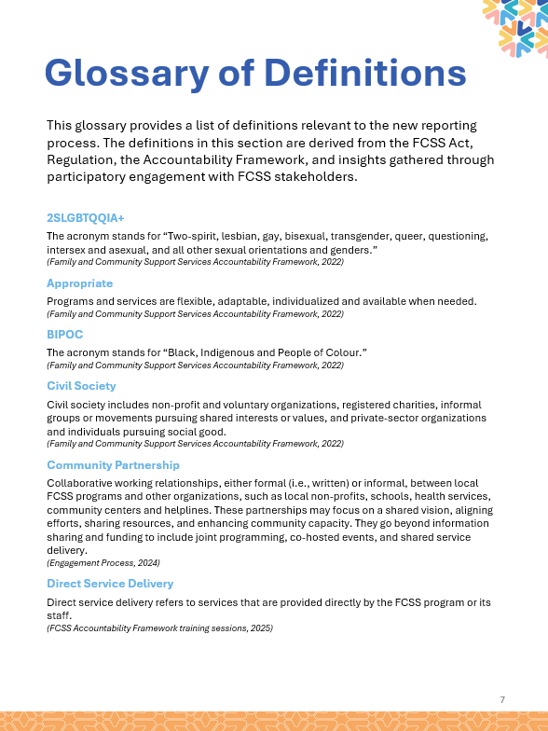


Glossary of Definitions
More Information
Training Package
Pages 7-11
A full list of definitions related to reporting can be found in the Glossary of Definitions.
The definitions listed in the glossary were developed or refined using the Accountability Framework or participatory processes with the Director’s Network.
Notes:
As we complete this module, we will mention the “Glossary of Definitions” resource, available in the training package.
This resource will be helpful throughout the training, as it clarifies key terms such as “participant”, “volunteer”, and “positive change.”
You can find these definitions on pages 7 to 11 of your training package.

Slide 24

Module 2
Knowledge Check
More Information
Training Package
Page 31
Q1: Which of the following documents make up the FCSS Policy Landscape? (select all that apply)
The FCSS Act
The FCSS Regulation
The FCSS Position Paper
The FCSS Accountability Framework
Notes:
Now, let us complete a quick knowledge check to reinforce what we have covered so far.
This activity includes four questions, and if you would like to follow along, you will find them listed on page 31 of your training package.
As you work through each question, feel free to circle the correct answers directly in your training package.
Question 1 is: Which of the following documents make up the FCSS Policy Landscape? (Select all that apply)
A) FCSS Act
B) FCSS Regulation
C) FCSS Position Paper
D) FCSS Accountability Framework
You may pause the video here to consider your answer before continuing.
The correct responses for this one are:
The FCSS Act
The FCSS Regulation, and the
FCSS Accountability Framework

Slide 25

Module 2
Knowledge Check – Question 2
More Information
Training Package
Page 31
Q2: What is the primary purpose of the six Prevention Strategies? (select one)
To eliminate all risk factors
To enhance protective factors
To focus on intervention after issues arise
To reduce the impact of unavoidable risk factors
Notes:
Question 2 is: What is the primary purpose of the six Prevention Strategies?
Is the purpose:
A) To eliminate all risk factors
B) To enhance protective factors
C) To focus on intervention after issues arise
D) To reduce the impact of unavoidable risk factors
You may pause the video here to consider your answer before continuing.
The correct answer for this one is:
B) To enhance protective factors
The six Prevention Strategies are designed to strengthen protective factors that support individual, family, and community well-being; rather than focusing on eliminating risk or responding after challenges emerge.

Slide 26
Module 2
Knowledge Check – Question 3
More Information
Training Package
Page 31
Q3: What is the primary purpose of the 5 Provincial Prevention Priorities? (select one)
To describe risk factors
To describe the outcomes of FCSS programming
To describe protective factors
To describe key social issues impacting Albertans
Notes:
Our third knowledge check question is: “what is the primary purpose of the 5 Provincial Prevention Priorities”?
Is it:
To describe risk factors
To describe the outcomes of FCSS programming
To describe protective factors
To describe key social issues impacting Albertans
You may pause the video here to consider your answer before continuing.
The Answer for this one is “D”; the five provincial prevention priorities describe the key social issues impacting Albertans.

Slide 27

Module 2
Knowledge Check – Question 4
More Information
Training Package
Page 31
Q4: How many Key Performance Measures will FCSS Programs report on? (select one)
13
11
9
10
Notes:
Now, question #4
How many Key Performance Measures will FCSS programs be responsible for reporting on?
Is it:
13
11
9
10
You may pause the video here to consider your answer before continuing.
The answer for this one is B), FCSS programs will be responsible for reporting on 11 key performance measures, with the province responsible for the other two.

Slide 28
Module 3
Activity Categorization
Notes:
Welcome to module 3.
This module aims to help you understand a new task, that is being introduced in the 2026 reporting process, called activity categorization.

Slide 29
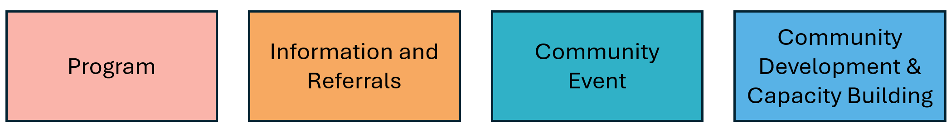
Activity Categorization
Service Types
More Information
Training Package
Page 14 - 21
KPMs:
Number of programs funded through local FCSS programs by delivery type, population group, priority and strategy
Amount and percentage of funding by delivery type, population group, priority & strategy
The above are the four (4) service types, based on the types of activities that FCSS programs already do.
The service types sort FCSS work into a few major categories, based on their focus and format.
Some service types also have types and subtypes to help further categorize them.
In addition, a fifth service type exists for “direct assistance” for emergencies only. Communities will require permission to report on this service type.
Notes:
As you will see here, there are four categories of activities that you will be asked to select for each of the things your FCSS program does.
This new categorization was designed to provide a standardized approach for reporting program activities, eliminating the need for "free text" or "description" fields that you use now.
In addition to the four “service types,” some activity types include subtypes to assist with further classification, which we will discuss later in this module.
For activities that have subtypes, you will be asked to select one response using the most relevant classification available under each category.
To support your understanding of this section, you can refer to the “Activity Categories and Descriptions” section on pages 14 through 21 of your training package.
The development of these four categories was guided by input from an advisory group made up of FCSS directors, and this information was further validated through a survey conducted among all FCSS directors across Alberta.
In addition, these categories were developed based on an analysis of the programs that have been reported on over the years.
That said, we know not every program will fit perfectly, and that is okay.
If that is the case for your FCSS program, select the category that fits best for your activity.
Based on feedback from the live training session, a fifth service type, “Direct Assistance,” was added for when communities that experience emergencies utilize FCSS funding after receiving permission from the Minister of Assisted Living and Social Services.
If you still have trouble with categorizing your activities or if there is an activity that you are doing that is not in the activity categorization chart, please contact the provincial FCSS team by phone or email for assistance.

Slide 30
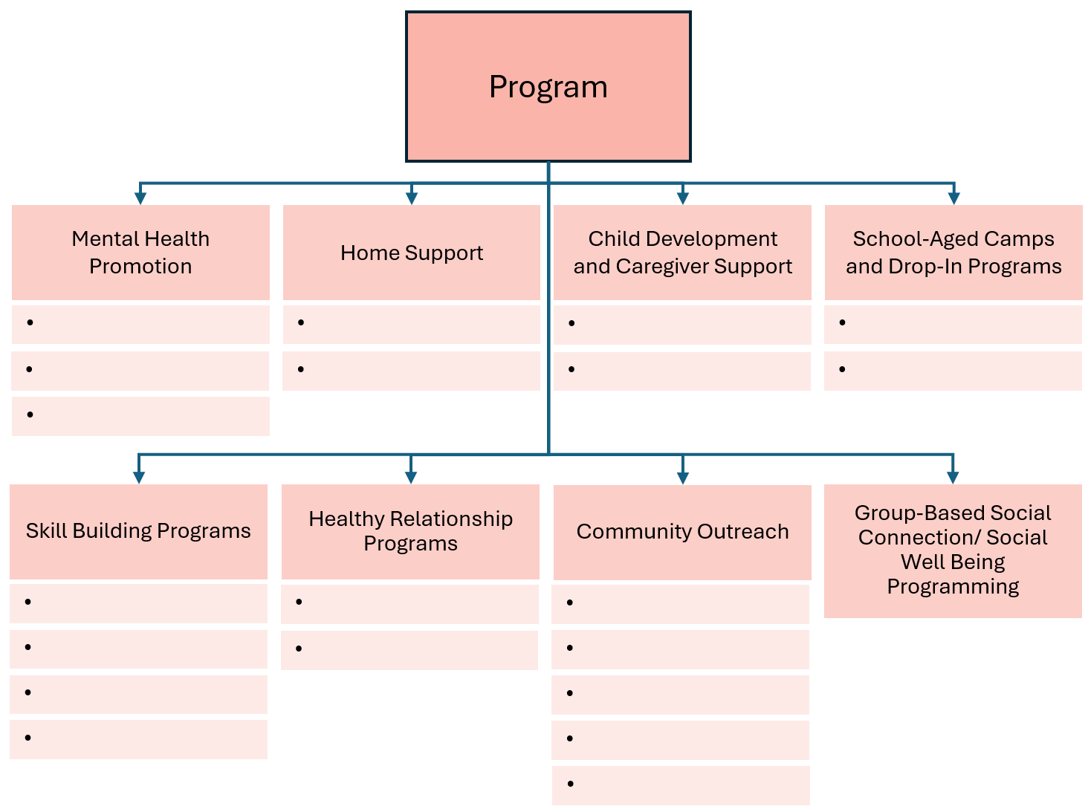
Activity Categorization
Programs
More Information
Training Package
Page 15 -18
A Program is a service offering intended to support community members as participants.
Participation is typically recurrent or ongoing, where participants attend more than once.
Programs can be further categorized into 8 Program Types.
Select the best fit – there are no “right” or “wrong” answers.
Notes:
Let us start with the first grouping of activities, which is programs.
If we look first at the description of a program on page 15 of your training package, you will see that a program is described as a service offering intended to support community members as participants.
Programs are further categorized by Program Types and Subtypes.
Participation is typically recurrent or ongoing, where participants attend more than once.
When you are asked to categorize a program by its “type” and “subtype” during reporting, please know that there are no right or wrong answers; we are looking for the “best fit.”
Some programs will obviously belong in certain categories, while others might not fit perfectly into any one spot, and some could even belong to multiple classifications.
As mentioned before, if you have trouble with categorizing your activities, please contact the provincial FCSS team by phone or email for assistance.

Slide 31
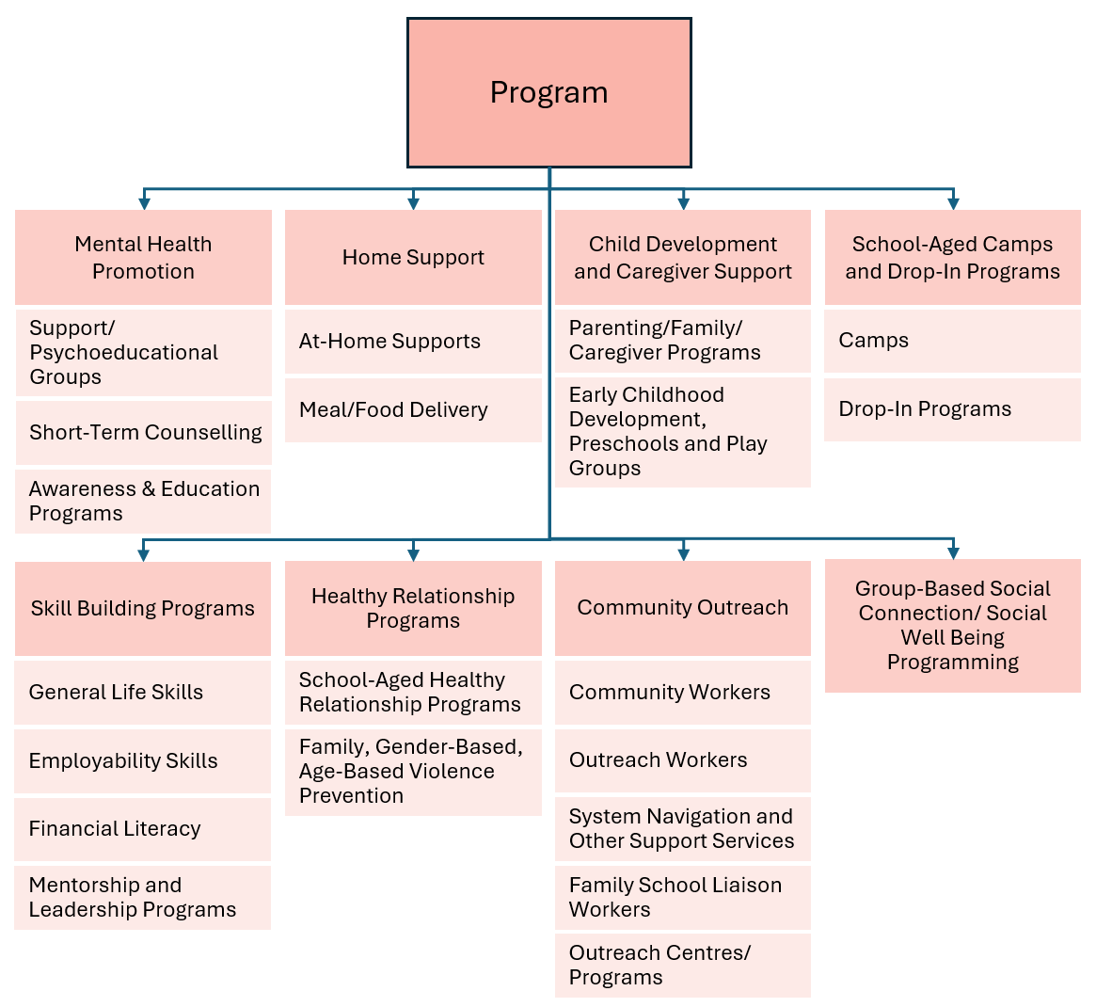
Activity Categorization
Programs - Example
More Information
Training Package
Page 15 -18
Example: A meal delivery service for seniors residing at home. Your FCSS supports the coordination of the service.
Which type is the best fit?
Which subtype is the best fit?
Notes:
Now, let us cover a couple of examples. We will start with a simple one.
Picture a meal delivery service that supports seniors living at home.
In this scenario, your FCSS program is responsible for coordinating the service.
Now, look at the program descriptions on pages 15 to 18 of your training package.
Based on what you see there, which program type and subtype do you think best fits this example?
You may pause the video here to consider your answer before continuing.

Slide 32
Activity Categorization
Programs – Example (Answer)
More Information
Training Package
Page 15 -18
Example: A meal delivery service for seniors residing at home. Your FCSS supports the coordination of the service.
Which type is the best fit?
Which subtype is the best fit?
Notes:
Now, let us review the answer.
The type that may fit best for this example is Home Support with the sub-type of Meal/Food Delivery.
However, it is worth mentioning that at-Home Support is also an appropriate option.
This example shows that there can be multiple categorizations, and you only need to select one.
We recommend selecting the option that aligns best, and it is okay if it does not match perfectly with a type or sub-type.

Slide 33
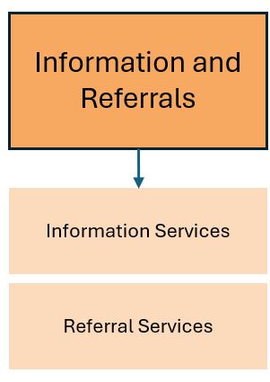
Activity Categorization
Information & Referrals
More Information
Training Package
Page 19
Information & Referrals are activities or services that involve staff or volunteers informing community members about available services or making referrals.
These interactions are generally transactional, one-time interactions.
The purpose is to capture the interactions that FCSS programs have with Albertans that are not participating in an FCSS program, including walk-ins and telephone calls.
Notes:
Our next category is “information and referrals.”
The general description, as outlined on page 19 of your training package, is that Information and Referral activities are services that involve staff (or volunteers) informing community members about available services or making referrals.

Slide 34
Activity Categorization
Information Services & Referral Services
More Information
Training Package
Page 19
Type: Information Services
Type: Referral Services
When staff or volunteers provide community members with information about local programs and services.
These are usually one-time interactions that do not typically involve active support.
Examples include:
A booth or venue at a non-FCSS event to hand out information
Maintaining community directories
Welcome kits for new residents
Community mail-outs
When staff or volunteers connect individuals or families with other services.
Referrals involve actively bridging to another service by providing targeted resources, supporting an individual in booking an appointment or doing a "warm handoff".
They are generally one-time interactions but may have follow-ups.
Examples include:
In-person referrals
Referrals over the phone
Notes:
As mentioned, there are two types here....
The first is “information services.”
This is the type of activity where staff or volunteers provide community members with information about local programs and services.
These are usually one-time interactions that do not involve active support, or an understanding of the specific needs of an individual.
Some examples of this include an information booth where your staff are handing out pamphlets, the maintenance of community directories, the creation of welcome kits for new residents or community mail-outs.
The second type is “referral services,” defined as the type of activity where staff or volunteers connect individuals or families with other services.
Referrals involve actively bridging to another service by providing targeted resources, supporting an individual in booking an appointment, or through a “warm handoff” to a community partner.
Referral services are also generally one-time interactions.
Before moving on, let us cover a quick example of the difference between 'information' and 'referrals.’
Sharing information is kind of like putting it out into the universe…you are making it available.
A referral, on the other hand, is much more direct…you know the specific needs required by the individual and you provide specific information to assist them with their needs or refer them to a community partner that can help them out.

Slide 35
Activity Categorization
Information & Referrals - Example
More Information
Training Package
Page 19
Example: An individual came into your FCSS seeking information about food security resources in the community. The front desk staff pointed them to a local food bank. A warm handoff was conducted to ensure the individual was actively bridged to the food bank. No personal information was collected, and there was no follow-up or ongoing engagement. This was a single, one-time interaction.
Which type is the best fit?
Which subtype is the best fit?
Notes:
Now, let us cover an example.
In this scenario, an individual walks into your FCSS office looking for information about food security resources in the community.
They do not go through a formal intake process. However, a team member at the front desk provides a warm handoff to their contact at the local food bank, ensuring the individual is actively bridged to the support they need.
No personal information is collected, and there is no follow-up or ongoing engagement by the FCSS program. This is a single, one-time interaction.
Take a moment to think about how you might classify this type of interaction using the program types and subtypes in your training package.
For this example:
We would classify it as a referral service—because it is a one-time, immediate connection to another organization without ongoing involvement, and it involved more than just giving information.

Slide 36
Activity Categorization
Community Events
More Information
Training Package
Page 20
A Community Event is an organized occurrence that has a focus on prevention by promoting engagement and belonging for community members. This is typically a one-time activity.
Often marks a specific time of year or specific day (like a holiday or a day of remembrance)
It may be associated with seasonal activities or a theme that is meaningful to the community
Has “attendees” rather than “participants”
Some examples include:
Community Connection Cinema
Connection-building activities and group discussions while watching a movie
Stronger Together: Celebrating and Connecting Seniors
Intergenerational activities to foster social connections and celebrate seniors’ contributions to the community
Community Event
Notes:
The next category is community events.
Community events are organized activities that have a focus on prevention designed to foster engagement and a sense of belonging among community members.
Community events should be anchored in prevention efforts such as reducing social isolation or enhancing protective factors.
Typically, these events occur as one-time activities; people attending events are referred to as "attendees.“
Unlike the other three categories of activities, “community events” do not have additional types.
Examples of community events, grounded in prevention, can include:
A “Community Connection cinema with connection-building activities and small group discussions that help neighbors connect and build lasting relationships, while also watching a movie during the event.
Or a seniors week celebration with intergenerational activities, wellness workshops, and community resources where the focus is on fostering social connections, supporting healthy aging, and celebrating seniors’ contributions to the community.

Slide 37
Activity Categorization
Community Development & Capacity Building
More Information
Training Package
Page 20
Community Development and Capacity Building
Community Development and Capacity Building includes activities that promote, encourage, and facilitate the development of stronger communities through the strengthening of FCSS programs. These activities typically involve volunteers and/or staff.
Examples include:
volunteer recruitment, training, coordination, recognition
staff training, leadership development
strategic planning, needs assessments, evaluation
partnership building, interagency work, boards/committees
partner or public engagement
community capacity building
Volunteerism
Staff and Board Development
Partnerships, Agency and Community Capacity Building
Assessment, Consultation and Evaluation
Notes:
Next, the category of “Community Development and Capacity Building”
This category includes activities that promote, encourage, and facilitate the development of stronger communities through the strengthening of FCSS programs. These activities typically involve volunteers and staff.
There are four sub-types of Community Development and Capacity Building including:
Volunteerism: which includes actions and initiatives that enhance the capacity for volunteerism and acknowledge the contributions of volunteers to local FCSS programs.
Staff and board development: which includes things like training, conferences, and leadership development.
Partnerships, agency and community capacity building, and
Assessment, consultation and evaluation
These categories are further detailed on page 20 of your training package.

Slide 38
Activity Categorization
Direct Assistance (Emergencies Only)
More Information
Training Package
Page 21
According to section 2.1(3) of the Family and Community Support Services Regulation, services provided under a program may offer direct assistance including money, food, clothing or shelter to sustain an individual or family during a public health emergency under the Public Health Act or any extenuating circumstances such as fire or flood as the Minister may determine.
For more information or assistance, please contact the provincial FCSS team.
Direct Assistance
(Emergencies Only)
Public Health Emergency
Extenuating Circumstances
Notes:
Finally, based on feedback during the live training sessions, clarification was requested on how to report on the use of FCSS funding during emergencies approved by the Minister of Assisted Living and Social Services.
Only once you have received approval from the Minister to use FCSS funds for emergencies are you able to report on “direct assistance” activities related to the use of FCSS funding in your annual report.
For more information or assistance, please contact the provincial FCSS team.

Slide 39
Activity Categorization
More Information
Training Package
Page 32
Instructions:
Read the activity description for each example.
Identify the activity category that fits best.
Identify the type and subtype, if applicable.
Notes:
To wrap up this section, we will walk through four practice examples.
You will find the activity on page 32 of your training package.
You will also want to refer to the activity categorizations chart and descriptions on pages 15 to 18.
For each example, your task is to:
Read the description carefully.
Identify the most appropriate service category.
Select a subtype, if applicable.
As you work through the examples, keep in mind that there may be more than one possible answer.
The goal is to identify the best fit based on the primary purpose of the activity.

Slide 40
Activity Categorization Example: Snow Removal Program
Program
Information and Referrals
Community Events
Community Development & Capacity Building
Mental Health Promotion
Home Support
Child Development and Caregiver Support
School-Aged Camps and Drop-In Programs
Information Services
Volunteerism
Support/ Psychoeducational Groups
At-Home Supports
Parenting/Family/ Caregiver Programs
Camps
Referral Services
Staff and Board Development
Meal/Food Delivery
Early Childhood Development, Preschools and Play Groups
Drop-In Programs
Short-Term Counselling
Partnerships, Agency and Community Capacity Building
Awareness & Education Programs
Assessment, Consultation and Evaluation
Skill Building Programs
Healthy Relationship Programs
Community Outreach
Group-Based Social Connection/ Social Well Being Programming
General Life Skills
School-Aged Healthy Relationship Programs
Community Workers
Employability Skills
Family, Gender-Based, Age-Based Violence Prevention
Outreach Workers
Activity: Snow removal program
Target Participants: Seniors
Activity Goal: To help seniors stay mobile and independent by having volunteers clear snow from driveways and sidewalks, making it easier for them to get out and about in their neighbourhoods.
Financial Literacy
System Navigation and Other Support Services
Mentorship and Leadership Programs
Family School Liaison Workers
Outreach Centres/ Programs
Notes:
The first activity example is a snow removal program that supports seniors.
The goal of the activity is to help seniors stay mobile and independent by having volunteers clear snow from driveways and sidewalks, making it easier for them to get out and about in their neighborhoods during the winter!
Pause the video now and take a moment to classify this activity.
For this example, we classified the service type as “program” because it is a recurring service offered to community members.
A possible type is “home support” because it is a service provided at home to support seniors.
A possible subtype is “at-home supports” as it fits best within services provided at home.

Slide 41
Activity Categorization Example: One-day Information Fair
Program
Information and Referrals
Community Events
Community Development & Capacity Building
Mental Health Promotion
Home Support
Child Development and Caregiver Support
School-Aged Camps and Drop-In Programs
Information Services
Volunteerism
Support/ Psychoeducational Groups
At-Home Supports
Parenting/Family/ Caregiver Programs
Camps
Referral Services
Staff and Board Development
Meal/Food Delivery
Early Childhood Development, Preschools and Play Groups
Drop-In Programs
Short-Term Counselling
Partnerships, Agency and Community Capacity Building
Awareness & Education Programs
Assessment, Consultation and Evaluation
Skill Building Programs
Healthy Relationship Programs
Community Outreach
Group-Based Social Connection/ Social Well Being Programming
General Life Skills
School-Aged Healthy Relationship Programs
Community Workers
Employability Skills
Family, Gender-Based, Age-Based Violence Prevention
Outreach Workers
Activity: One-day information fair
Target Participants: Anyone in the community
Activity Goal: To raise awareness about the different kinds of resources available in the community.
Financial Literacy
System Navigation and Other Support Services
Mentorship and Leadership Programs
Family School Liaison Workers
Outreach Centres/ Programs
Notes:
The next example is a one-day information fair for anyone in the community where the goal is to raise awareness about the different kinds of resources available in the community
Pause the video now to consider how you would classify this activity.
The service type for this is “information and referrals” because it is an activity with the primary purpose of informing community members of available resources and services.
A possible subtype is “information services” because the activity is a one-time event with the purpose of providing information about the resources available – not specifically for giving referrals.

Slide 42
Activity Categorization Example: Volunteer Recruitment & Coordination
Program
Information and Referrals
Community Events
Community Development & Capacity Building
Mental Health Promotion
Home Support
Child Development and Caregiver Support
School-Aged Camps and Drop-In Programs
Information Services
Volunteerism
Support/ Psychoeducational Groups
At-Home Supports
Parenting/Family/ Caregiver Programs
Camps
Referral Services
Staff and Board Development
Meal/Food Delivery
Early Childhood Development, Preschools and Play Groups
Drop-In Programs
Short-Term Counselling
Partnerships, Agency and Community Capacity Building
Awareness & Education Programs
Assessment, Consultation and Evaluation
Skill Building Programs
Healthy Relationship Programs
Community Outreach
Group-Based Social Connection/ Social Well Being Programming
General Life Skills
School-Aged Healthy Relationship Programs
Community Workers
Employability Skills
Family, Gender-Based, Age-Based Violence Prevention
Outreach Workers
Activity: Volunteer recruitment and coordination
Target Participants: Volunteers for a community event
Activity Goal: To find, onboard, and coordinate volunteers for the event.
Financial Literacy
System Navigation and Other Support Services
Mentorship and Leadership Programs
Family School Liaison Workers
Outreach Centres/ Programs
Notes:
The third example is a volunteer recruitment and coordination activity where the participants are volunteers for a community event and the goal of the activity is to find, onboard, and coordinate volunteers for the event.
Pause the video now to consider how you would classify this activity.
For this example, the service type is “community development and capacity building” because it is an activity that is primarily meant for volunteers.
The possible type here is “volunteerism,” as that is the only subtype that is for volunteer orientated activities.

Slide 43
Activity Categorization Example: Intergenerational Buddies
Program
Information and Referrals
Community Events
Community Development & Capacity Building
Mental Health Promotion
Home Support
Child Development and Caregiver Support
School-Aged Camps and Drop-In Programs
Information Services
Volunteerism
Support/ Psychoeducational Groups
At-Home Supports
Parenting/Family/ Caregiver Programs
Camps
Referral Services
Staff and Board Development
Meal/Food Delivery
Early Childhood Development, Preschools and Play Groups
Drop-In Programs
Short-Term Counselling
Partnerships, Agency and Community Capacity Building
Awareness & Education Programs
Assessment, Consultation and Evaluation
Skill Building Programs
Healthy Relationship Programs
Community Outreach
Group-Based Social Connection/ Social Well Being Programming
General Life Skills
School-Aged Healthy Relationship Programs
Community Workers
Employability Skills
Family, Gender-Based, Age-Based Violence Prevention
Outreach Workers
Activity: Intergenerational Buddies
Target Participants: Children and Elders
Activity Goal: To foster healthy, supportive connections in the community between different generations over weekly sessions.
Financial Literacy
System Navigation and Other Support Services
Mentorship and Leadership Programs
Family School Liaison Workers
Outreach Centres/ Programs
Notes:
Our final example is an “intergenerational buddies” activity that targets both children and seniors.
The goal of this activity is to foster healthy, supportive connections in the community between different generations over weekly sessions.
Pause the video now and reflect on how you would categorize this activity.
For this the activity type we selected “program” because it is providing a recurring service to community members.
Some possible types are
“healthy relationship programs”,
“child development and caregiver support”, or
“skill building programs”
All of these seem to be good fits, which highlights that the process of categorizing activities is not a perfect science and may differ depending on the community needs and program goals.
Some possible subtypes are:
“school aged healthy relationship programs” OR
“parenting/family/caregiver programs” OR
“mentorship and leadership programs” … depending on the type chosen.
To help refine your categorization efforts, it is helpful to have additional information regarding the purpose and intent of the program.
For instance, if the objective of the intergenerational program is for seniors to model healthy relationships and share their skills with younger generations, it could be classified under “school-aged healthy relationship programs.”
Conversely, if the focus is on seniors imparting their leadership skills to children, it would fit within a “mentorship and leadership” subtype.
Or… if the program's intent revolves around fostering intergenerational relationships between senior caregivers and children, it could be categorized as a “parenting/family/caregiver” program subtype.

Slide 44
Module 3.1
Prevention Continuum
Notes:
Welcome to Module 3.1.
This module will cover the prevention continuum and how to categorize your activities in line with the levels of prevention within the accountability framework.
This module was added based on feedback from the live training sessions.

Slide 45

The Prevention Continuum
More Information
Training Package
Page 22
“
Prevention is a proactive process that strengthens the protective factors of individuals, families and communities to promote well-being, reduce vulnerabilities, enhance quality of life, and empowers them to meet the challenges of life.
”
Primary
Root causes of social issues
Secondary
Issues at early stage
Tertiary
Immediate needs & direct support
In Scope
Notes:
In Module 2, we covered this slide which introduced both a common definition of prevention and a very brief overview of the prevention continuum.
Prevention, in the context of FCSS and as the common definition suggests, focuses on enhancing protective factors to improve well-being and prevent issues before they occur or at an early stage before they require crisis supports.
Crisis supports are part of tertiary prevention services, which fall outside the scope of FCSS programming.
The three level of prevention are:
Primary prevention – which addresses root cause of social issues
Secondary prevention – which addresses issues at an early stage, and
Tertiary prevention – which provides immediate needs and direct support
As a reminder, activities that provide direct support to individuals or community (e.g., tertiary prevention) are only allowed under exceptional circumstances, such as a public health emergency or as determined by the Minister of Assisted Living and Social Services in emergency situations. Minister approval is required in advance.
As part of updates to the reporting requirements based on feedback gathered during the live training sessions, FCSS programs will, as part of their annual reporting process, identify each activity as either a primary prevention activity or a secondary prevention activity.
This categorization is a key component of the Accountability Framework and ensures that programs are categorized with the appropriate level of prevention.

Slide 46
Prevention Continuum Table
More Information
Training Package
Page 22
FCSS Services | Primary Prevention | Address root causes of social issues with focus on the general population or a specific population. Promote protective factors in the physical and social environment (including social relationships). Can include awareness programs, enhancing connections among community organizations and promoting community volunteerism.
 | Secondary Prevention | Address issues at an early stage for specific groups or at-risk populations. Strengthen the capacity of individuals and communities to prevent or reduce risk factors and build resilience. Can include connecting those in need with appropriate resources and skill development.
Additional services permitted only during a public health emergency or extenuating circumstance, as determined by Minister. | Tertiary Prevention (Out of Scope) | Address immediate needs with intent to prevent long-term impacts. Support individuals or groups already affected by social issues by providing direct services. Can include direct assistance such as food, clothing and shelter.
Notes:
Along the prevention continuum, the three levels of prevention have key characteristics which separate them.
Primary prevention, as defined in the Framework, relates to activities that:
Address root causes of social issues with focus on the general population or a specific population.
Promote protective factors in the physical and social environment (including social relationships).
Can include awareness programs, enhancing connections among community organizations and promoting community volunteerism.
Secondary prevention relates to activities that:
Address issues at an early stage for specific groups or at-risk populations.
Strengthen the capacity of individuals and communities to prevent or reduce risk factors and build resilience.
Can include connecting those in need with appropriate resources and skill development.
Finally, tertiary prevention activities, which are considered out of scope for FCSS programs are activities that:
Address immediate needs with intent to prevent long-term impacts.
Support individuals or groups already affected by social issues by providing direct services.
Can include direct assistance such as food, clothing and shelter.
As a reminder, activities that offer direct assistance (such as food, closing, shelter) cannot use FCSS funding, unless they have been granted permission by the Minster of Assisted Living and Social Services in an emergency or during a public health emergency.
If you have difficulty categorizing your activity as either primary or secondary prevention for your activities, please contact the FCSS provincial team by phone or email for assistance.

Slide 47
Module 4
Prevention Strategies
Notes:
Welcome to Module 4.
This module is intended to provide you with an understanding of prevention strategies and outline how they tie into the new reporting process.
As mentioned in module 3, you will start by categorizing the activity, and then choosing a type and sub-type, where applicable.
Then, you will select the level or prevention, either primary or secondary, that aligns best with your activity.
In this module, we build on activity categorization and the levels of prevention by identifying at least one prevention strategy for each activity.

Slide 48
FCSS Accountability Framework
Prevention Strategies
More Information
Training Package
Page 13
Promote and encourage active engagement in community
Foster a sense of belonging
Promote
social inclusion
Things FCSS programs can do to enhance protective factors
Develop and maintain healthy relationships
Enhance access to social supports
Develop and strengthen skills that build resilience
Notes:
As a reminder, there are six different prevention strategies:
List all strategies in order (top left to right to bottom)
As mentioned in module two, prevention strategies are the things that programs do to enhance protective factors.
For your reference, these strategies are listed on page 13 of the training package.

Slide 49

Prevention Strategies & Reporting
FCSS programs will connect prevention strategies to programs, community events and community development and capacity building activities:
FCSS programs need to choose the prevention strategy or strategies that match your program goals, aims, or objectives
KPMs:
Number of programs funded through local FCSS programs by delivery type, population group, priority and strategy
Amount and percentage of funding by delivery type, population group, priority & prevention strategy
FCSS participants who reported positive change on measures associated with prevention strategies after participating in local FCSS programming
Program
Community Events
Community Development & Capacity Building
Information and Referrals
Notes:
When selecting prevention strategies within the new reporting:
you will be asked to identify what prevention strategies best align with your programs, community events, and community development and capacity building activities.
As you have likely noticed on the slide, you will not be asked to link them to information and referral activities at this time.
When you are inputting your annual report into the FCSS online system at the end of each year, you will be asked to select the prevention strategy (or strategies) that best fit your activity goals.
You are required to choose at least one prevention strategy; however, you can select multiple strategies if they align with your activity.
Although you can select all of the prevention strategies, on average we imagine that you would choose between two and four prevention strategies

Slide 50
Activity
Aligning Prevention Strategies with Programs
More Information
Training Package
Page 33
Instructions:
Read the program description for the case study.
Identify the relevant prevention strategy or strategies.
Identify the relevant activity categories and any types or subtypes.
Notes:
Let us go through an example of how you will put this into practice.
Before proceeding to this activity, make sure you have read the program description for case study #1, so you are able to select the prevention strategy (or strategies) that fit best.
We will also build on what we learned in module 3 by categorizing the case study activities and looking at any relevant types or subtypes.
Feel free to use the worksheet on page 33 of the training package if you want to have a physical worksheet to use.
As a reminder:
you can reference the prevention strategies list on page 13
The activity categorization chart and descriptions are on pages 14 through 21

Slide 51


Case Study
More Information
Training Package
Page 33
Activity: Six-week after-school program at the park
Target Participants: Children in grades 1~6
Programming Goal: To bring children together to interact, foster connections, and participate in collaborative activities that enhance confidence, promote problem-solving skills, and nurture compassion, all while enjoying the outdoors.
Identify:
Relevant activity category, type, and sub-type
Relevant prevention strategy or strategies
Notes:
Let us dive into a case study example to apply our knowledge.
This activity is a six-week after-school program at the park for participants in grades 1 through 6.
The programming goal is to bring children together to interact and make connections with each other while enjoying the outdoors
First let us select the relevant activity category, type, and subtype.
Secondly, let us identify the relevant prevention strategy or strategies.
You may pause the video here if you want to write the answers down before you continue.
Okay - now, let us go to the answers on the next slide to check our work.

Slide 52
Case Study: Answer
More Information
Training Package
Page 33
Activity: Six-week after-school program at the park
Target Participants: Children in grades 1~6
Activity Categories:
Program > Healthy Relationship Programs > School-Aged Healthy Relationship Programs
Prevention Strategies:
#2 – Foster a sense of belonging
#6 – Develop and strengthen skills that build resilience
Notes:
For activity categories we selected:
That this was a program.
The type being “Healthy Relationship Programs”
And the sub-type being “School-Aged Healthy Relationship Programs”
We selected this as a program because it is a re-occurring service offered to community members.
The focus of the program is to help children build connections, so they type can be a relationship-based program. This is why the possible types and subtypes focus on building relationships.
For this example, the prevention strategies we selected were:
#2, Foster a sense of belonging AND
#6, develop and strengthen skills that build resilience
We identified two possible prevention strategies for this case because this after school program can both foster a sense of belonging and help children develop a sense of self and social skills.
Here’s something to note: the program description in this example is somewhat limited in detail.
As a result, the prevention strategies you choose may vary.
These are not the only potential answers.
If you were operating this type of program in your community, you would have a clear understanding of your prevention strategies and activity categorizations based on the context of your community.
In identifying prevention strategies, we are focused on identifying the best fit answer.

Slide 53
Module 5
Provincial Prevention Priorities
Notes:
Welcome to Module 5.
The purpose of this module is to make sure that you understand the provincial prevention priorities and their relevance to the new reporting process.

Slide 54

FCSS Accountability Framework
Provincial Prevention Priorities
More Information
Training Package
Page 12
Homelessness and Housing Insecurity
Mental Health and Addictions
Employment
Family and Sexual Violence
Aging Well in Community
Notes:
As mentioned in Module 2, the five provincial prevention priorities highlight they key social issues affecting Albertans.
For your reference, page 12 of your training package provides additional context around these five priorities, which include:
Homelessness and housing insecurity
Mental Health and Addictions
Employment
Family and Sexual Violence
AND
Aging Well in Community

Slide 55


Prevention Priorities & Reporting
FCSS programs will connect prevention priorities to programs, community events, AND community development and capacity building activities.
Prevention priorities may not match activities specifically but should be relevant and aligned with the overall purpose and vision.
FCSS programs will choose one prevention priority for each activity that is the best fit.
KPMs:
Number of programs funded through local FCSS programs by delivery type, population group, priority and strategy
Amount and percentage of funding by delivery type, population group, priority & prevention strategy
Program
Community Events
Community Development & Capacity Building
Information and Referrals
Example, resume workshop program: With which prevention priority is this program best aligned?
Notes:
In the context of reporting, you will be asked to connect the provincial prevention priorities to three of the four categories of activities including:
Programs
Community events, and
Community development and capacity building ..
Like Module 4, you will not be required to link the provincial prevention priorities to Information and Referrals at this time.
For the prevention priorities you will select only one prevention priority for each activity.
While you may identify all relevant prevention strategies that apply to your activities, you will identify only one provincial prevention priority.
We recognize that this may be a tough ask – your activities are inherently preventative and that they often contribute to many of the prevention priorities.
However, we will be asking that you identify the prevention priority that best aligns with your activity.
We are asking this because, when multiple prevention priorities are selected, it can complicate the data analysis and dilute the understanding of the specific focus areas for activities.
These prevention priorities may not match activities perfectly but should be relevant and aligned with the overall purpose and vision of the prevention priorities.
During this module, we will dedicate some time to examine how you can align your activities with the priorities (both proactively and retroactively).
As with module three and four, please know that there will be situations where there will not be a definitive answer to creating connections between activities and a prevention priority;
However, like in the other modules, we are emphasizing and focusing on “best fit”.
Before moving to the next slide, we want to highlight a quick example of how you would be asked to report on what “provincial prevention priority” is tied to a program.
For example, if we were hosting a “resume workshop program” the “provincial prevention priority” we could select for this program could be prevention priority #3: employment.
We selected this prevention priority because this activity can give people the skills to find jobs, which aligns with reducing unemployment.

Slide 56

Identifying a Prevention Priority
The following questions can assist you in navigating the process from identifying the activity (point A) to understanding its alignment with a prevention priority (point B).
What is the activity?
What are the prevention strategies?
Consider the protective factors: Identify the protective factors this activity builds for individuals or communities. What are the results of these factors & what situations do they prevent?
How does this align to a prevention priority?
Consider what you want to accomplish: What change do you aim to achieve? Now link that change to the bigger picture: how does it help prevent or tie to a prevention priority.
Notes:
Because the work of FCSS programs are preventative in nature, the connection between what the activity is, to how it aligns with a prevention priority may not be straight forward.
We have developed this slide which provides some brainstorm prompts to get you from point A (what is the activity) to point B (how it aligns to a prevention priority).
During the creation and facilitation of the live training sessions, we have found that getting to the identification of the best-fit happens in different ways.
One way to think about the “best fit” for a prevention priority is to:
Consider the protective factors:
Consider what the protective factors the activity builds for individuals or communities.
You can also ask yourself some questions like:
What are the results of these factors OR
What situations do they prevent?
You can also consider the desired outcomes and objectives:
Asking question like:
What change are you ultimately aiming to achieve?
From there, you can now link that change to a prevention priority.
In this first year of reporting, we understand that you may find it difficult to choose a prevention priority for your activities.
You have existing programs and activities and will likely find yourself identifying a prevention priority after setting your plans, rather than pinpointing a priority first and then building a program around it.
Over time, we hope that these prevention priorities can guide and inform the way you design and plan your programs in your communities.

Slide 57
Example: Pathway to Identifying a Prevention Priority (using protective factors)
Consider the protective factors: Identify the protective factors this activity builds for individuals or communities. What are the results of these factors & what situations do they prevent?
What is the activity?
What are the prevention strategies?
How does this align to a prevention priority?
Community support/
outreach worker program for young adults
#1 - Encourage active engagement in community.
#5 - Enhance access to social supports.
#6 - Develop and strengthen skills that build resilience.
Consider the desired outcomes: What change do you aim to achieve? Now link that change to the bigger picture: how does it help prevent or tie to a prevention priority.
Homelessness and Housing Insecurity
Notes:
Let us go through an example to help put this into practice.
Here, we have an activity that is a:
Community support worker program for young adults.
Tying this back to the prevention strategies, we can point to prevention strategies 1, 5, and 6, which include:
Promote and encourage active engagement in the community
Enhance access to social supports, and
Develop and strengthen skills that build resilience
If we want to use the route of “protective factors” to help us get to the prevention priory we can first:
Look at what protective factors are being built,
Well, we know that this type of program encourages participants to…
have connections to the community,
build problem solving skills and
gain knowledge of available supports.
The results of these protective factors are that the skills built through this program allows young adults to:
cope with and navigate life transitions as well as access supports and resources.
When we think about “what situations the protective factors prevent”, we can draw a connection to the protective factors:
preventing homelessness for young adults because they can gain skills to take care of themselves.
Finally, we can draw the connection that preventing homelessness aligns with the provincial prevention priority of “homelessness and housing insecurity”
However, the prevention priority could have also been “employment” or “mental health and addictions”
Which really illustrates the fact that there can be multiple answers – it all depends on the context of your community, your activity goals, and other factors.
As we have mentioned throughout this training - There is no one correct answer, you are looking for best fit.
Another route you can take is to think about the outcomes and what change do you aim to achieve through the program and then link that change to the bigger picture: how does this activity help prevent something or how does it relate to a prevention priority.
Ultimately, you’re just peeling things back and thinking about the provincial prevention priority that you are having an impact on.

Slide 58

Activity
Layering Reporting Concepts
Retroactive Program Alignment
Proactive Program Alignment
More Information
Training Package
Page 34 - 35
Notes:
Activity time!
In this activity, we will go through two examples demonstrating how FCSS programs can align activities with the Accountability Framework and the six provincial prevention priorities.
We will examine one example of a "retroactive fit,“ where we will align an existing FCSS activity with a prevention priority and other elements of the accountability framework in previous modules.
We will also explore a “proactive" program alignment, where we will focus on a specific community need and discuss how to design a program that aligns to the Accountability Framework.
You can refer to the handouts on page 34 and page 35 of the training package to follow along with this activity.

Slide 59
Activity
Layering Reporting Concepts
More Information
Training Package
Page 34
How does this activity align with:
Activity Categorization
Programs (indicate subtypes, if applicable)
Child Development and Caregiver Support
Parenting/Family/Caregiver Programs
Information and Referrals
Community Events
Community Development and Capacity Building
Retroactive Program Alignment
Activity: Parenting group
Target Participants: Parents and caregivers of youth
Programming Goal: To increase parents’ and caregivers’ skills and confidence in building positive relationships with their youth
Additional Information: An ongoing group that meets regularly with a facilitator over 6 weeks.
Prevention Strategies (select all that apply)
#1 Promote and encourage active engagement in the community
#2 Foster a sense of belonging
#3 Promote social inclusion
#4 Develop and maintain healthy relationships
#5 Enhance access to social supports
#6 Develop and strengthen skills that build resilience
Provincial Prevention Priorities (select best fit)
#1 Homelessness and housing insecurity
#2 Mental health and addictions
#3 Employment
#4 Family and sexual violence across the lifespan
#5 Aging well in the community
Notes:
We will first look at an example of retroactive program alignment; this is where we will look at an example of an activity and figure out how it aligns with the prevention priorities, prevention strategies, and activity categorizations.
Before jumping in, we want to remind you that we are striving for the “best fit” and that there definitely can be multiple “correct” answers here.
To support with this activity, we have:
Worksheet on page 34
The activity categorization chart on pages 15 through 18
The prevention strategies list on page 13, and
The provincial prevention priorities on page 12
The activity that we’re going to be working with is a “parenting group” where the target participants are “parents and caregivers of youth”.
The programming goal is to “increase parents’ and caregivers’ skills and confidence in building positive relationships with their youth.
This is an ongoing group that meets regularly with a facilitator over 6 weeks.
Question : Let’s start off with “activity categorization. Which activity, type, and sub-type might work best for this activity.
For your reference, you can use the activity categorization chart and descriptions on pages 15 through 21 to support this.
Answer: because this is a recurring service, it can be labelled as a “program” and it focuses on caregivers as the main target audience, so the type could be “Child Development and Caregiver support” and the subtype could be “Parenting and Caregiver Programs.”
Next: Which prevention strategy or strategies could apply for this activity?
Answer: the one strategy that we’ve indicated is “develop and maintain healthy relationships” – We have chosen this because the parenting group’s goal is to build positive relationships, and prevention strategy #4 is a good description of that goal.
A note here: you may choose more than one prevention strategy; however, we have only selected one for this example.
Question: Finally, let us look at the provincial prevention priorities – take a moment to consider how the program aligns with the provincial prevention priorities.
Answer: The priority we indicated was “family and sexual violence across the lifespan” – this priority is not a perfect fit for this program, but it does build protective factors for families. By a process of elimination, this is the best fit prevention priority for this activity.
This activity was intended to be an example of how to align an existing program.

Slide 60
Activity
Layering Reporting Concepts - Proactive
More Information
Training Package
Page 35
How does this need align with:
Activity Categorization
Programs (indicate subtypes, if applicable)
Mental Health Promotion
> Short-Term Counselling
Information and Referrals
Community Events
Community Development and Capacity Building
Proactive Program Alignment
Needs Assessment Results:
Community members facing significant levels of stress, particularly youth dealing with mental health challenges.
How could the Accountability Framework guide program design?
Prevention Strategies (select all that apply)
#1 Promote and encourage active engagement in the community
#2 Foster a sense of belonging
#3 Promote social inclusion
#4 Develop and maintain healthy relationships
#5 Enhance access to social supports
#6 Develop and strengthen skills that build resilience
Provincial Prevention Priorities (select best fit)
#1 Homelessness and housing insecurity
#2 Mental health and addictions
#3 Employment
#4 Family and sexual violence across the lifespan
#5 Aging well in the community
Notes:
In this next activity, we will take look at a “community need,” and explore how a program could be designed in alignment with the Accountability Framework in response to this need.
You can use the worksheet on page 35 of your training package to jot down your thoughts and ideas.
The goal of this example is to show how the Accountability Framework can be used during the activity design process.
We consider this exercise a “proactive program fit” since we are focusing on developing a brand-new program using the Accountability Framework instead of using an existing FCSS program to fit within the Accountability Framework.
This example comes from a needs assessment highlighting that community members, especially youth dealing with mental health challenges, are under a lot of stress.
Start by looking at the community need in your example and think about what kind of activity you might implement to address that need.
Use the activity categorization chart and descriptions on pages 15 through 21 to help guide your thinking.
Once you have landed on an activity, the next step is to figure out which prevention strategies it aligns with and then identify the provincial prevention priority that fits best.
You may pause the video here to review your work before you continue.
Answers:
For an activity category, we thought about “what kind of program can support stress for youth and young adults”
So, we chose:
Activity is a program Programs > Mental Health Promotion > Short-Term Counselling
The program is a recurring service, so it is a “Program.”
For Prevention Strategies, we may want this program to:
(2) Foster a sense of belonging
(5) Enhance access to social supports
(6) Develop and strengthen skills that build resilience
And finally, in the category of Provincial Prevention Priorities, we chose:
Mental health and addictions;
the needs assessment was about mental health, so this prevention priority seemed like the best fit.

Slide 61
Module 6
Counting
Notes:
Welcome to module 6.
This module will outline how you will monitor count-based key performance measures, specifically those related to unique volunteers and volunteer hours, community partnerships, participant interactions, attendees, and referral interactions.

Slide 62






Counting at-a Glance
More Information
Training Package
Page 23
Programs are required to keep track of counts related to:
5 KPMs Measured Through Counting
Number of times Albertans participated in local FCSS programming
Number of referral services provided by local FCSS programs
Number of community partnerships local FCSS programs have with other local FCSS programs, agencies and/or programs
Number of volunteers who supported FCSS programs
Number of volunteer hours reported by local FCSS programs
Volunteers
Partnerships
Participant Interactions
Attendees
Referral
Interactions
Notes:
The count based measurements in the FCSS Accountability Framework contribute to five key performance measures (as shown on the right-hand side of the screen).
For your reference, page 23 in the training package provides a high-level overview on who and what should be counted.

Slide 63

Volunteers
More Information
Training Package
Page 23
Volunteer
Someone who contributes to the program without receiving ongoing monetary compensation for their time.
Students who are receiving a school credit or community service hours for their time.
Community organization employees who dedicate time above and beyond their paid roles, including ’corporate volunteers’ (e.g., municipality staff who volunteer to support a program).
NOT included in volunteer count
Volunteers who attended a volunteer appreciation event.
Volunteers are reported as a TOTAL SUM OF UNIQUE VOLUNTEERS and a TOTAL SUM OF VOLUNTEER HOURS for ALL activities.
Notes:
Let us start off with counting unique volunteers and volunteer hours.
A volunteer is someone who lends their time and skills to an FCSS activity without getting paid for it.
This may include students who are working towards school credit or community service hours, or, say, community organization employees who go the extra mile beyond their paid jobs to support a program outside of their regular work hours.
For your reference, pages 7 through 11 of your training package contain a glossary of definitions, including a definition of "volunteers.“
As with current reporting, you should only count the time that individuals are volunteering. So, for example, time spent at a volunteer appreciation event does NOT count towards your unique volunteer numbers or hours.
This slide gives you a good overview of who qualifies as a volunteer and when they should be counted.
FCSS programs will be responsible for reporting two counts related to volunteers, including the:
total number of unique volunteers that support a FCSS program, and
the total number of volunteer hours across all FCSS activities.

Slide 64
Community Partnerships
More Information
Training Package
Page 23
Community Partnership
Collaborative working relationships, either formal (i.e., written) or informal, between local FCSS programs and other organizations, such as local non-profits, schools, health services, community centers and helplines.
FCSS programs will be required to include the TOTAL SUM of community partnerships.
Notes:
Up next, we will have a look at counting community partnerships.
A community partnership is being defined as a collaborative working relationship, which is either formal (i.e., written) or informal, between local FCSS programs and other organizations, such as local non-profits, businesses, schools, health services, community centers and similar organizations.
FCSS programs are required to include the total count of community partnerships throughout the year.

Slide 65
Participant Interactions
More Information
Training Package
Page 23
Participant
Interaction
Program
Anyone who formally or informally uses or takes part in a FCSS activity, service, or program, including those who receive services or assistance.
Anyone who registers and participates in specific programming.
Individuals who use drop-in services or attend single session programs or receive system navigation support.
Participants are accounted for in every interaction. For example, if two participants register for a program consisting of five sessions, each participant will be counted for each session attended, resulting in a total of ten participant interactions (2 participants x 5 sessions = 10 total participations).
Notes:
Now we will talk about participant interactions.
Participant interactions are relevant to the key performance measure, "Number of times Albertans participated in FCSS programming.“
For the new reporting, you will not need to report “unique participants” but rather the number of times people engaged or interact with programming.
As an example, if two participants register for a program consisting of five sessions, each participant will be counted for every session attended.
So, for this example, the total number of participant interactions would be 10.
That is 2 participants times 5 sessions. This total of 10 is the figure that should be reported.
This is a bit of a change, and we recognize that this number may seem large when you report it, especially for things like after-school programs that happen every day.
The value of counting participant interactions for FCSS activities is the engagement with community members to build protective factors, over time, and every interaction supports that.
We know that this is a lot of counting, particularly if you have a recurring program that requires daily attendance tracking.
With that in mind, further details will be provided in supplemental resources around this, but it is okay to use sampling as a method for counting participants.
As an example, if you were to use sampling, we would ask you to track the total number of individuals registered for the program and the number of sessions conducted, allowing for calculation based on these figures.
We will also mention that you won’t be counting any participants in the category of “community development and capacity building” – participant interactions related to programs ONLY.
This is because it is often staff or volunteers that are involved in community development and capacity building activities.
As a key takeaway for this slide, you will be required to report the number of interactions you have with community members for each program, rather than the number of unique individuals served.

Slide 66
Attendees
More Information
Training Package
Page 23
Attendee
Community Events
Anyone who attends or takes part in any way in a community event.
If there is no formal registration, an estimated attendee number may be submitted.
Notes:
Moving on to the activity type of community events, for this category, you’ll be counting the number of attendees.
As with participants, attendee counts are relevant to the key performance measure, "Number of times Albertans participated in FCSS programming."
An attendee in a community event is simply anyone who attends or takes part in any way in a community event. These attendees should be included in counts for reporting.
However, this attendee count does not include volunteers who are supporting the event in a volunteer capacity and staff who are being paid to be there. This is because volunteer contributions are captured separately through the reporting of volunteer hours.
If there is no formal registration, an estimated participant number may be submitted, but it would be great if you could do your best to have accurate counts where possible.

Slide 67
Information & Referrals
More Information
Training Package
Page 23
Reported as # of referral interactions (e.g., in-person referrals, phone referrals, indirect referral service through 211 funding)
NOT reported as the # of people or the # of activities taking place within a referral interaction
Referral Services
Examples:
A family of four walks in and receives two referrals, the family of four is considered a unit. This is one referral interaction, not four separate interactions.
Two friends walk in seeking their own separate referrals/resources, they are two distinct units. This would count as two referral interactions
Information
Services
NOT reported (e.g., information booth, welcome kits, mail-outs, community directories)
Notes:
Finally, let us talk about referral services.
For the activity category type of referral services:
You will report referrals based on the number of what we will be calling referral interactions rather than the number of individuals served (or the number of pieces of information given out)
So, this is any interactions in which an individual or family may:
receive one or multiple referral(s)/resource(s)
receive follow-up after a previous referral interaction
receive assistance in reaching out to a service
be supported to book an appointment
be supported through a warm hand-off
Regardless of the activities during the interaction, it would count as one in the referral interactions count.
There are two examples on the screen to illustrate how these counts take place:
Example 1: A family of four walks in and receives two referrals, the family of four is considered a unit. This is one referral interaction, not four separate interactions.
For referrals, the scope of the referral needs to be considered. If a family attends their local FCSS and receives two referrals for services that benefit the family as a whole (such as family counselling and the food bank), it would be considered one referral interaction. Whereas if a family attends their local FCSS and the grandmother is referred to a senior’s support group, and the child is referred to a children’s day program, it would be considered two referral interactions.
Example 2: Two friends walk in seeking their own separate referrals/resources, they are two distinct units. This would count as two referral interactions
A new update for our 2026 reporting is that sampling can be used to ease the tracking process, alleviating the challenges associated with manually tallying each referral. Further details on the sampling method will be provided in supplemental resources, which will be available at a later date.
As you can see at the bottom of the screen, information services such as materials distributed at information booths, welcome kits, mail outs, and community directories are not included in any sort of counting. While these activities are wonderful and important, we are not requesting you to report any counts related to them.

Slide 68


Activity
Knowledge Check – Question 1
More Information
Training Package
Page 36
Q1: What is the FCSS definition of a “volunteer”?
Someone who contributes to the program without receiving ongoing monetary compensation for their time.
Students who are receiving a school credit or community service hours for their time.
Community organization employees who dedicate time above and beyond their paid roles, including ‘corporate volunteers.’
Notes:
Our next question is focusing on when we would count a participant interaction.
When:
A) A person participates in a community support group program.
B) A person receives a visit at home for an outreach support program.
C) A volunteer who attends a volunteer appreciation event, OR
D) An FCSS staff member who attends a working group
The answers are based on the definition of a participant in the new reporting template, meaning that both A and B are correct answers.
C would be incorrect as a volunteer appreciation event is categorized as a community development and capacity building activity. Anyone who attends these types of events are not included in participant counts.
D is also incorrect because a working group would also be categorized as a community development and capacity building activity.

Slide 69

Activity
Knowledge Check – Question 2
More Information
Training Package
Page 36
Q2: Over the course of the year, two unique volunteers each contributed their time to three distinct FCSS activities. How should these two unique individuals be counted in the annual report to reflect their contributions across multiple programs?
As two unique volunteers
As six volunteer participations
As three volunteer time entries
Notes:
Our second question is: Over the course of the year, two unique volunteers each contributed their time to three distinct FCSS activities. How should these two unique individuals be counted in the annual report to reflect their contributions across multiple programs?
The answer is “as two unique volunteers.”
While each volunteer is counted only once in the total number of volunteers reported across all programs, this approach is not meant to diminish the value of their contributions. The impact of a volunteer’s involvement, whether in one program or many, are recognized through the number of hours contributed, which are reported separately and help reflect the full scope of their support.
A note for this one, we want each volunteer counted once (as in unique volunteers), recognizing that it could be very difficult to track that across several indirect service deliveries, we encourage programs to do your best when counting unique volunteers.

Slide 70

Activity
Knowledge Check – Question 3
More Information
Training Package
Page 36
Q3: In which of these scenarios would we count a participant interaction?
A person participates in a community support group program.
A person receives a visit at home for an outreach support program.
A volunteer who attends a volunteer appreciation event.
An FCSS staff member attends a working group.
Notes:
Our next question is focusing on when we would count a participant interaction.
When:
A) A person participates in a community support group program.
B) A person receives a visit at home for an outreach support program.
C) A volunteer who attends a volunteer appreciation event, OR
D) An FCSS staff member who attends a working group
The answers are based on the definition of a participant in the new reporting template, meaning that both A and B are correct answers.
C would be incorrect as a volunteer appreciation event is categorized as a community development and capacity building activity. Anyone who attends these types of events are not included in participant counts.
D is also incorrect because a working group would also be categorized as a community development and capacity building activity.

Slide 71

Activity
Knowledge Check – Question 4
More Information
Training Package
Page 36
Q4: A parent registers for a six-session playgroup and attends all six sessions with their child. How many times should the parent’s participation be counted in reporting?
As ONE participant interaction.
As SIX participant interactions.
As THREE participant interactions.
Notes:
Our last question relates to counting participant interactions.
The question is: A parent registers for a six-session playgroup and attends all six sessions with their child. How many times should the parent’s participation be counted in reporting?
The answer for this one is six participant interactions; because the key performance measure is measuring the number of times community members are participating.
Participation is counted as the number of times participants are attending programs or events.
Because of this, although they are only one participant, if they attended 6 sessions, they are counted as having 6 participant interactions.

Slide 72
Module 7
Choosing Categories
Notes:
Welcome to Module 7.
In this module, we will give an overview of choosing age categories and community groups.

Slide 73
Choosing Categories
KPM:
Number of programs funded through local FCSS programs by delivery type, population group, priority and strategy.
Notes:
The associated Key Performance Measure is the “Number of programs funded through local FCSS programs by delivery type, population group, priority and strategy”

Slide 74
Choosing Age Categories
More Information
Training Package
Page 24
You will need to choose an age category for:
Choose the age category of the intended or primary audience.
Example: Snow removal program for Seniors
Age category is Seniors, as defined by your program
Example: After-school program - Grades 1-8
Age category is Children (<12) because it is primarily for a younger audience, even though some older kids can also attend.
It is okay if you do not have a specific age group.
Age Categories
All ages (no specific target)
Children (<12)
Youth (12-17)
Children and Youth (<18)
Adults (18+)
Family (see Glossary definition)
Seniors, as defined by your program
Program
Community Events
Notes:
In the new reporting template, you will have to indicate age categories when reporting:
Programs, and
Community events.
You will be able to select up to two age categories that correspond to the intended or primary audiences
It is completely okay if there is no specific age group.
You will notice some changes in the categories – that is because the previous method of reporting demographic data led to overlapping categories
This complicated the ability to summarize the data, and this change aims to improve clarity.
A significant update in reporting is the emphasis on identifying the primary intended audience(s) for activities, which is the main group or groups for whom the program aims to build or enhance protective factors.
The definition of "Seniors" has been purposely left open for each FCSS to determine, meaning it does not necessarily have to apply to individuals aged 65 and older.
A “family” is defined as a combination of child or youth and adult in a caregiving role. An “adult in a caregiving role” can be defined as anyone responsible for the care and well-being of a child or youth, and may include parents/stepparents, grandparents, foster parents, relatives, or another adult acting in a parenting role.
It is perfectly alright not to have a defined target group for your program; an "All ages" designation is valuable as it indicates the program's support for the entire community.
If there are multiple age group targets for a program, you can now choose up to two, reflecting the intent and goals of the program or community event.

Slide 75

Choosing Community Groups
More Information
Training Package
Page 24
Community Groups
No specific community group
Indigenous peoples
Optional Dropdown: First Nations, Métis, Inuit.
2SLGBTQQIA+ people
Newcomers
People with disabilities
Racialized people
Language minority groups
Women/girls
Men/boys
You will need to choose community group for:
Choose the community group of the intended or primary audience, if applicable.
Example: Welcome Wellness: Building Healthy Starts for Newcomers
Community group is Newcomers, even if other racialized people and language minority groups may attend, the program INTENT is for newcomers.
Example: Short-term preventative counselling
Community group is No specific community group because the program has not been tailored to a specific community group – even if it was created for an age group.
Program
Community Events
Notes:
Choosing community groups for an FCSS program or community event is like choosing an age category.
FCSS programs must chose one, and may choose up to two, community groups as the intended primary audience(s).
The community groups that will be used in the new reporting template are shown on the right-hand column of this slide.
A community group should only be selected for an FCSS program IF it was a primary intended audience, but it’s okay if there was no specific community group intended for the program – a “No specific community group” option can be chosen for those cases.
An FCSS program will not be viewed as a better program if it selects multiple community groups, we ask that you select only the primary intended group(s) or the “No specific community group” option.
We have a couple examples to walk through to explore this requirement.
The first examples is a program called “Welcome Wellness: Building Healthy Starts for Newcomers.
For this example, our community group is:
Newcomers, even if groups such as racialized people and language minority groups may attend, the program INTENT was for newcomers.
The second example is a short-term preventive counselling for youth. The community group is: No specific community group because the program has not been tailored to a specific community group – even if it was created for an age group.

Slide 76
Module 8
Surveying
Notes:
Welcome to module 8.
This module will focus on how you will use survey questions in the new accountability framework reporting.
Surveying is something that you are already doing in the current reporting system, so this will have flavours of familiarity.

Slide 77
Surveying at-a Glance
More Information
Training Package
Page 41 - 51
Required: FCSS programs are required to survey at least one program, but we encourage surveying multiple programs to achieve a more thorough analysis!
Optional: You may also survey community events and community development and capacity building.
3 KPMs Measured Through Surveys
Percentage of FCSS participants who expressed satisfaction with FCSS programs/services
Percentage of FCSS participants who report that FCSS programs/services were easy to access
Percentage of participants who reported positive change on measures associated with prevention strategies after participating in local FCSS programming
Program
Community Events
Community Development & Capacity Building
Information and Referrals
Notes:
As is currently the practice, FCSS programs are required to survey at least one program.
However, we do recommend taking the time to survey multiple programs.
You can use the insights gathered during surveying to support improvement for your current activities or planning for your future programming.
You might also consider surveying community events along with community development and capacity-building activities, but that’s optional!
We will cover that at the end of this module.
It is also worth mentioning that you will not survey anything related to information and referrals.
Surveying is not new, and you are already doing it under the current reporting process. We are just streamlining the process.
In the past, the FCSS survey bank had over 600 questions. The new “question catalogue” simplifies things down to just 50.
We have a fresh-looking list of survey questions, each linked to a Key Performance Measure (KPM).
This question catalogue can be found on pages 41 through 51 of your training package.
The new question catalogue still retains some of the classics, you will find that the top 30 measures reported by programs over the last two years appear in ways that align with the accountability framework.
Turning our attention to the right-hand column of this slide, you will see that there are three key performance measures that you will be assessing through survey responses, each of which have their own associated survey questions outlined in the question catalogue.

Slide 78

Likert Scales
More Information
Training Package
Page 42
Each survey question can be answered using a 5-point Likert agreement scale.
Standard Likert
Strongly Disagree | Somewhat Disagree | Neither Agree nor Disagree | Somewhat Agree | Strongly Agree
Using Emojis or Images
Strongly Disagree | Somewhat Disagree | Neither Agree nor Disagree | Somewhat Agree | Strongly Agree
😩 Strongly Disagree | 🙁 Somewhat Disagree | 😐 Neither Agree nor Disagree | 🙂 Somewhat Agree | 😀 Strongly Agree
Simplify the Language
I don’t agree at all | I don’t agree | I’m not sure | I agree a little bit | I agree completely
Not at all | Not really | Kind of | A little bit | Definitely
Notes:
Before we go into specific examples, let us talk a bit more about the tools to respond to a survey question.
Each survey question can be answered using a 5-point Likert agreement scale.
The "5-point" part means there are five different options to choose from, and "agreement" tells us how much someone agrees or disagrees with the statement being asked.
We understand that kids and some other groups might find a 5-point scale difficult to understand.
FCSS programs may use plain language or adapt the wording of survey questions, as long as the intent of the question remains unchanged. This flexibility allows programs to ensure questions are clear, accessible, and appropriate for their audiences. Programs are also encouraged to be innovative in how they administer surveys, whether through paper forms, digital tools, interviews, or creative engagement methods, so long as the data collected aligns with the intended performance measures.
On this slide, we have suggested some alternatives, like using emojis or images alongside the scale, or simplifying the wording to make it more relatable.

Slide 79
Surveying at-a Glance
Satisfaction Associated with FCSS Programs
More Information
Training Package
Page 43
Key Performance Measure: Percentage of FCSS participants who expressed satisfaction with FCSS programs/services.
Survey Questions | Question # | Post-Only
 | 1 | Overall, I am satisfied with this program/service.
Notes:
We are going to look first at selecting the two simplest Key Performance Measures that will be addressed through surveying.
Selecting a survey question to measure the Key Performance Measure associated with “percentage of participants who expressed satisfaction with FCSS programs and services” is straightforward, as there is only ONE specific post-only survey question dedicated to this purpose.
This question can be found on page 43 of the training package, in the question catalogue section… and this question is “overall, I am satisfied with this program/service.”

Slide 80
Surveying at-a Glance
Ease of Access
More Information
Training Package
Page 43
Key Performance Measure: Percentage of FCSS participants who report that FCSS programs/services were easy to access
Survey Questions | Question # | Post-Only
 | 1 | Overall, I found this program/service easy to access.
Notes:
Turning now to our second Key Performance Measure, selecting the question for tracking “the percentage of FCSS participants who report that FCSS programs/services were easy to access”.
This one is also an easy one to address, as this Key Performance Measure also only has one post-survey question, which is question number 2 on page 43 of the training package in the question catalogue section.
This question is “overall, I found this program/service easy to access.”

Slide 81
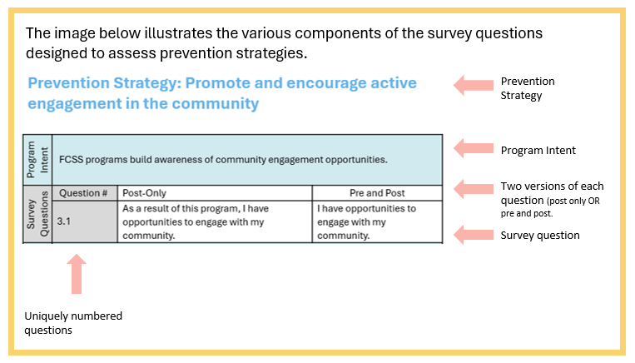
Surveying at-a Glance
Positive Change Associated with Prevention Priorities
More Information
Training Package
Page 44 - 49
Key Performance Measure: Percentage of participants who reported positive change on measures associated with prevention strategies after participating in local FCSS programming.
Notes:
As mentioned, there are different sections of the question catalogue, which are associated with the different key performance measures, and we will now turn our attention to the section related to measuring positive change associated with the prevention strategies.
You can refer to pages 44 through 49 of the training package in the questions catalogue section, which outlines several survey questions related to the prevention strategies.
As shown in the image, and as you will see in the question catalogue, survey questions related to positive change are nested under the corresponding prevention strategy.
Each survey question is available in two formats: a post-only version (as shown on the left), which can be used when you want to conduct a survey only AFTER the completion of the activity.
The second option includes both pre- and post-versions, you might want to consider to assess changes in responses before and after the program. In this case, you would ask the same question both before and after the activity.

Slide 82

Designing Your Survey Approach
When designing your survey, stay within SCOPE to ensure it delivers meaningful results!
S - Select the program to survey
C - Choose when to survey
O - Opt for survey questions that:
Align with and measure prevention strategy
Measure satisfaction
Measure access
P - Prepare survey questions
E - Evaluate your choices
Notes:
When pulling together a survey, it can be easy to get carried away trying to collect too much information or adding extra questions that are not directly relevant.
That is why we emphasize staying in SCOPE, which is an approach to keeping your surveying efforts focused, impactful, and collecting information in alignment with the Key Performance Measures.
Start by SELECTING the activity, or activities, that you want to survey; remember that at least one activity needs to be surveyed.
We then CHOOSE when to survey; meaning that you need to decide if you want to survey participants only once at the end of a program, and use post-only survey questions, or if you want to survey participants at the beginning and at the end, you will want to use pre- and post- versions of the survey questions.
Next you will OPT for survey questions that align with the intended prevention strategy or strategies of the activity, and you will also use the questions to measure the other two key performance measures related to satisfaction and access.
You will then PREPARE the survey questions; know that not all questions under prevention strategies need to be included in the surveys. Use your judgement for which questions are most appropriate to ask.
Finally, EVALUATE your choices – you should always reflect on the suitability and accessibility of the Survey Questions for program participants – for example, is the language level appropriate for newcomers? Is the font big enough for seniors, and similar considerations.
As mentioned beforehand, FCSS programs may use plain language or adapt the wording of survey questions, as long as the intent of the question remains unchanged. This flexibility allows programs to ensure questions are clear, accessible, and appropriate for their audiences. Programs are also encouraged to be innovative in how they administer surveys, whether through paper forms, digital tools, interviews, or creative engagement methods, so long as the data collected aligns with the intended performance measures.

Slide 83


Surveying Example
More Information
Training Package
Pages 41 - 51
Program Short-term counselling
Target Participants Anyone – individuals, families, youth
Program Goal
To strengthen community members’ coping skills to navigate challenges.
Key Performance Measures (KPMs)
Choose when to survey
Identify prevention strategies related to the activity
Choose related survey questions
Percentage of FCSS participants who expressed satisfaction with FCSS programs/services
Survey Question 1
“Overall, I’m satisfied with this program/service”
Post only
Percentage of FCSS participants who report that FCSS programs/services were easy to access
Survey Question 2
“Overall, I found this program/service easy to access.”
Post only
Notes:
Here, we will go through an example together around surveying before jumping into our survey activity.
You will need to refer to the Survey Questions on pages 41 through 51 of your training package, in addition to the prevention strategies list on page 13
In this example, we are looking at a “short term counselling” program targeting anyone, and the goal of the program is to “strengthen community members’ coping skills to navigate challenges”
If this is the activity we are surveying, we will want to survey all three survey-based Key Performance Measures.
When we look at the first Key Performance Measure in the orange box, which is the percentage of FCSS participants who expressed satisfaction with FCSS programs and services, selecting this survey question is straightforward, as there is only one option. Which is survey question #1.
Similarly, for the Key Performance Measure of “the percentage of participants who report that programs were easy to access, there is, again, only one option, survey question #2.

Slide 84

Surveying Example Continued
More Information
Training Package
Pages 41 - 51
Program Short-term counselling
Target Participants Anyone – individuals, families, youth
Program Goal
To strengthen community members’ coping skills to navigate challenges.
Key Performance Measures (KPMs)
Choose when to survey
Identify prevention strategies related to the activity
Choose related survey questions
Percentage of participants who reported positive change on measures associated with prevention strategies after participating in local FCSS programming.
Foster a sense of belonging
Enhance access to social supports
Develop and strengthen skills that build resilience
Any pre & post questions from “foster a sense of belonging,” such as:
4.1: I feel a sense of belonging to my community.
4.2: I feel connected to my community.
Any of the following pre-post questions from “enhance access to social supports,” such as:
7.1: I know what resources are available to [me/to my family].
7.2: I know places in the community I can turn to when I need help.
Any pre/post questions from “develop and strengthen skills that build resilience,” such as:
8.2: I have the ability to improve my life
8.3: I feel good about my future.
Pre AND Post to measure positive change before and after counselling.
Notes:
The final survey-based measure that we are going to look at is the percentage of participants who reported positive change on measures associated with prevention strategies after participating in local FCSS programming.
For this Key Performance Measure, we will want to select when we want to survey – in this example, we will choose a pre- and post- measure, but a post-only measure would work as well.
We’ll need to identify which prevention strategies align with the program to…
Choose the associated survey questions that are related to the prevention strategy.
In this example, any of the questions from the prevention strategies of “foster a sense of belonging”, “enhancing access to social supports” or “develop and strengthen skills that build resilience” could be a good fit here.
You should use your judgement for which questions would be appropriate to ask participants.
More than one survey question can be chosen in the final survey that is administered, and you can include any other questions that are not in the survey catalogue that may be useful to you.

Slide 85

Activity Selecting Survey Questions
More Information
Training Package
Page 37 – 38
Activity
Six week after-school program at the park
Target Participants Children in grades 1 to 6
Program Goal
To bring children together to interact and make meaningful social connections with each other while being in the outdoors.
Provincial Prevention Priorities
#1 Homelessness and housing insecurity
#2 Mental health and addictions
#3 Employment
#4 Family and sexual violence across the lifespan
#5 Aging well in the community
Prevention Strategies (select all that apply)
#1 Promote and encourage active engagement in the community
#2 Foster a sense of belonging
#3 Promote social inclusion
#4 Develop and maintain healthy relationships
#5 Enhance access to social supports
#6 Develop and strengthen skills that build resilience
Activity Categorization
Programs (indicate subtypes, if applicable)
Program →Healthy Relationship → School-aged healthy relationship program
Information and Referrals
Community Events
Community Development and Capacity Building
Notes:
Now that we have covered a few examples, let us check our knowledge through this activity.
In this activity, we will apply the reporting concepts that we have covered in training, including prevention priorities, activity categorization, selection of prevention strategies, and the selection of survey questions.
You can pause the video to complete the worksheet on pages 37 & 38 of your training package.
This scenario we will examine involves a six-week after-school program in the park for children in grades 1 to 6, with the objective of fostering social interactions and connections among children,
You will see, that the provincial prevention priorities, prevention strategies, and activity categorization have already been highlighted on the screen and in your training package.

Slide 86
Activity Selecting Survey Questions
More Information
Training Package
Page 37 – 38
Program
Six week after school program at the park
Target Participants Children in grades 1 to 6
Program Goal
To bring children together to interact and make connections with each other while enjoying the outdoors.
Key Performance Measures (KPMs)
Choose when to survey
Identify prevention strategies related to the activity
Choose related survey questions
Percentage of FCSS participants who expressed satisfaction with FCSS programs/services
Survey Question 1
Post only
Percentage of FCSS participants who report that FCSS programs/services were easy to access
Survey Question 2
Post only
Percentage of participants who reported positive change on measures associated with prevention strategies after participating in local FCSS programming
4.3
8.1
8.3
8.5
Foster a sense of belonging
Develop and strengthen skills that build resilience
Pre- Post
Notes:
What you will need to do is fill in the blanks related to “choosing when to survey” and “choosing related survey questions”.
Please feel free to pause the video to complete the worksheet on pages 37 & 38.
For our first Key Performance Measure for the percentage of participants who expressed satisfaction, this is a post-only survey question, and there is only one corresponding question in the question catalogue, which is question #1.
Similarly, for our second Key Performance Measure, there is also only one question available, which is a post-only question – question number #2.
Related to the Key Performance Measure for reporting positive Change:
We have selected to use pre- and post- questions, so that the impact of the program could be measured more accurately; However, you can also choose post only questions.
For prevention strategy “foster a sense of belonging”:
We chose question 4.3 “I feel important to my community.”
For prevention Strategy “develop and strengthen skills that build resilience,”
We chose question 8.1 “I feel good about myself.”
Another intent of this activity is that community members feel hopeful.
So, we also chose question 8.3 “I feel good about my future.”
A final program intent could be that community members have opportunities to learn and grow.
We can choose question 8.5 “I know about [how to have fun in nature].”

Slide 87



Optional Survey Questions
More Information
Training Package
Page 50 – 51
Collective Impact Survey Question
Page 49
Community Event Survey Questions
Page 49
Community Development and Capacity Building Survey Questions
Page 50
Notes:
To close off this module, we would like to highlight that along with the required survey questions tied to the Key Performance Measures, there are also some optional questions you can check out on pages 50 and 51 of your training package.
These additional questions were added based on feedback from our working group and cover a variety of topics.
You will find one question focusing on “collective impact,” several that can help guide your survey questions about community events, and others related to community development and capacity building.
Just because these questions are not directly connected to a Key Performance Measure, does not mean they are not important – there will also be a place in the annual report template to include survey responses related to these questions if you choose to use them.

Slide 88
Module 9
Impact Narratives
Notes:
Welcome to module 9.
In this section, we will be discussing a new optional reporting element of "impact narratives" and sharing tips on how to craft them for maximum effect while keeping within the word count.
We are excited about this new reporting element of “impact narratives” to be able to share examples, highlighting the tremendous work of FCSS programs across Alberta.

Slide 89

Impact Narratives
More Information
Training Package
Page 30
FCSS programs can report the impact of:
Impact Narrative: documented outcomes and effects of a program or initiative, showcasing its achievement and contributions at various levels.
Option to provide impact narrative for each of the four activity categories
Open-text fields with character limits
Reporting impact narratives is OPTIONAL
Program
Information and Referrals
Community Events
Community Development & Capacity Building
Direct Assistance
Notes:
We have included impact narratives in the reporting template because many FCSS programs expressed an interest in telling their unique impact stories with the provincial government.
For each of the four activity categories, you will be given the option to provide an impact narrative.
Impact narratives are open-text fields with character limits.
Impact narratives provide context and tangible examples to the provincial government to demonstrate the real impact of programs and services, and they can demonstrate impact that may be difficult to quantify.
That said, we want to emphasize that impact narratives are optional, and we know that telling impact narratives are an additional task in the reporting process.

Slide 90
Impact Narratives – STAR Method
More Information
Training Package
Page 30
SITUATION
Describe the situation or the problem that was addressed by the program.
E.g., our municipality receives a lot of snow in the winter that causes problems for seniors
TASK
Describe the goal that the program set out to achieve.
E.g., our snow removal program aimed to help seniors remove snow without hurting themselves
ACTION
Describe the specific actions that were taken to achieve the intended goal of the program.
E.g., we had volunteers clear the driveways of seniors who lived alone.
RESULT
Explain the positive change that resulted from the action.
E.g., seniors were able to safely leave their home in the winter and engage in community activities, building new relationships
Notes:
Impact narratives can be crafted using the STAR method.
Since there is a limited word count, using the STAR method can help you articulate your impact in a concise and descriptive way.
The example on this slide highlights how the STAR method can be used to craft an impact narrative.
In this example, we will first want to describe the situation or problem that was addressed by the activity:
In this example, it is that the municipality receives a lot of snow in the winter that causes problems for seniors
We will then want to describe the goal that the activity set out to achieve:
Which is that the snow removal program aimed to help seniors remove snow without hurting themselves
Then, we will describe the specific actions that were taken to achieve the intended goal of the program
Which is having volunteers clear the driveways of seniors who live alone
Finally, we will explain the positive change that resulted from the action:
Which is that seniors were able to safely leave their home in the winter and engage in community activities and build new relationships.
The STAR method can be used for crafting an impact narrative to help you to articulate a story in a way that is concise, yet descriptive.

Slide 91

Impact Narratives – Do and Do Not
More Information
Training Package
Page 30
DO
Be specific and use clear examples.
Share a real anonymous story of an individual or family who has benefitted from FCSS programming.
Focus on outcomes of the program instead of activities completed.
Align the narrative to the program goals.
Align the narrative to a prevention priority that best aligns.
DO NOT
Be vague and use buzzwords when describing the impact.
Reshare the same program data that were already reported elsewhere without giving additional context.
List the activities completed without talking about outcomes and impact.
Focus on program details (e.g., number of sessions, location, date) unless it will help you talk about the impact.
Notes:
Before going through an example of an impact narrative, we will touch quickly on some dos and do nots of sharing impact narratives.
In terms of the dos:
Be specific and use clear examples.
We would love if you could share a real anonymous story of an individual or family who has benefitted from FCSS programming.
Focus on outcomes of the activity instead of activities completed, and
Align the narrative to the program goals and prevention priorities.
And for the do not:
Please do not feel like you need to use buzzwords when describing the impact.
There is no need to reshare the same program data that you already reported elsewhere
List the activities completed without talking about outcomes and impact; and
Focus on program details (e.g., number of sessions, location, date) unless it will help you talk about the impact.

Slide 92
Impact Narratives – Example
More Information
Training Package
Page 30
Program: Community tax clinic
Target Participants: Anyone who needs help with their taxes – low-income and seniors.
Programming Goal: To provide tax assistance to people who otherwise struggle to complete their taxes and are therefore unable to apply for other benefits.
This year, our community tax clinic served a low-income senior who had not received tax benefits and refunds for the past 3 years because she had not completed her taxes. After filing taxes through the community tax clinic, she was able to receive the benefits she was entitled to. The tax clinic helped her feel connected to the community, reduced her financial anxiety, and enabled her to make positive lifestyle changes. Her story shows that our community tax clinic enhances access to social supports - in a way that contributes to aging well in community.
SITUATION
ACTION
RESULT
TASK
Notes:
Here, we have an example of a program for our impact narrative.
The program is a community tax clinic, and the target participants are anyone who needs help with their taxes.
The goal of the program is to provide tax assistance to people who otherwise struggle to complete their taxes and are therefore unable to apply for other federal benefits.
If we were to write an impact narrative using this example, it could look like this…
First, we’re describing the situation: This year, our community tax clinic served a low-income senior who had been unable to receive tax benefits she was entitled to for the for the past 3 years because she had not completed her taxes.
Next, we’re chatting about the action that was prompted: After filing taxes through the community tax clinic, she was able to receive the financial benefits she was entitled to.
Then, we then move to the result: Because of the tax clinic, her anxiety about her finances has decreased and she has been able to make positive lifestyle changes such as affording fresh produce again.
Finally, in this example, we are chatting about the task as it relates to the prevention strategies: Her story shows that our community tax clinic enhances access to social supports in a way that contributes aging well in community.

Slide 93
Module 10
Conclusions & Next Steps
Notes:
Welcome to Module 10.
Through the last 9 modules, we have covered a lot of details.
While we have discussed concepts in detail, it is important to explore how these elements integrate and work together within the reporting context.

Slide 94



3 Output Based KPMs
Key Details
More Information
Training Package
Page 25 - 26
 | Key Performance Measure | How it is Measured
 | Number of programs funded through local FCSS programs by delivery type (direct or indirect), population group, priority and strategy | Reporting of program category, type, population group, provincial prevention priority, and prevention strategy of each program
 | Amount and percentage of funding used by local FCSS programs by delivery type (direct or indirect), population group, priority and strategy | Funding associated with program category, delivery type, population group, provincial prevention priority, and prevention strategy of each program
 | Number and percentage of local FCSS programs that have completed a community needs assessment to inform their services | Completion of needs assessment
Notes:
As discussed earlier in the training, there are three “buckets” of Key Performance Measures including count based, survey based, and output based.
When we look at the three output-based Key Performance Measures, these include:
The number of programs funded through local FCSS programs by delivery type (direct or indirect), population group, priority and strategy.
The amount and percentage of funding used by local FCSS programs by delivery type (direct or indirect), population group, priority and strategy,
AND
The number and percentage of local FCSS programs that have completed a community needs assessment to inform their services. This is just simply a yes/no metric indicating if you have completed a community needs assessment, and if yes, what year it was completed in.

Slide 95


5 Count Based KPMs
Key Details
More Information
Training Package
Page 25 - 26
 | Key Performance Measure | How it is Measured
 | Number of times Albertans participated in local FCSS programming | Count of participant interactions (programs) or attendees (events)
 | Number of referral services provided by local FCSS programs | Count of referral interactions (if applicable)
 | Number of community partnerships local FCSS programs have with other local FCSS programs, agencies and/or programs | Count of partnerships
 | Number of volunteers who supported FCSS programs | Count of unique volunteers
 | Number of volunteer hours reported by local FCSS programs | Count of volunteer hours
Notes:
When chatting about the numbers and counts you will be keeping track of for annual reporting, this will include 5 Key Performance Measures, including:
The number of times Albertans participated in local FCSS programming (which will be measured through the count of participant interactions (programs) or attendees (events))
The number of referral services provided by local FCSS programs (which will be measured through referral interactions)
The number of community partnerships local FCSS programs have with other local FCSS programs, agencies, businesses, and/or programs (measured through the count of partnerships)
Number of volunteers who supported FCSS programs (measured through count of unique volunteers), and
Number of volunteer hours reported by local FCSS programs (the count of volunteer hours)

Slide 96

3 Survey Based KPMs
Key Details
More Information
Training Package
Page 25 - 26
 | Key Performance Measure | How it is Measured
 | Percentage of participants who reported positive change on measures associated with prevention strategies after participating in local FCSS programming | Positive change, from survey data
 | Percentage of FCSS participants who expressed satisfaction with FCSS programs/services | Survey question about satisfaction
 | Percentage of FCSS participants who report that FCSS programs/services were easy to access | Survey question about ease of access
Notes:
Finally, turning to survey based Key Performance Measures that are measured through survey-based means, including:
The percentage of participants who reported positive change on measures associated with prevention strategies after participating in local FCSS programming
The percentage of FCSS participants who expressed satisfaction with FCSS programs/services, and
The percentage of FCSS participants who report that FCSS programs/services were easy to access

Slide 97


2 Provincially Tracked KPMs
Key Details
More Information
Training Package
Page 26
 | Key Performance Measure | How it is Measured
 | Total economic contribution of volunteers (in dollars) | Calculated by Province
 | Provincial-level indicators related to provincial prevention priorities | Compiled by Province
Notes:
As mentioned, we have a total of 13 Key Performance Measures, 11 of which FCSS programs will be responsible for reporting on.
The other two Key Performance Measures will be reported on by the province.
Those Key Performance Measures are focused on tracking the total economic contribution of volunteers and some key provincial indicators that align with our prevention priorities.

Slide 98
Reporting Structure
Key Details - Overview
More Information
Training Package
Page 29
Section 1: Overview Reporting Table
Reporting Component | Required
Financial Information (Revenues and Funding) | Yes
Identification of whether a needs assessment has been conducted | Yes
Overview of Number of Community Partnerships | Yes
Number of Volunteers AND Volunteer Hours | Yes
Notes:
Here, we will outline the various components that FCSS programs be required to include, as well as those that will not be required, in the annual reporting.
We want to highlight that reporting will be organized into approximately five sections, as detailed on this slide.
And… this chart is also detailed on page 29 of your training package.
The first section is the general information that you need to report on. Things like:
Financial information
Overview of number of partnerships
Overview of all your different activity types
Number of volunteers and volunteer hours, and
Reporting related to whether a needs assessment has been completed (E.g., yes/no).

Slide 99
Reporting Structure
Key Details – Activity Reporting
More Information
Training Package
Page 29
 | Activity Reporting Table
 | Section 2 Programs | Section 3 Community Events | Section 4 Information and Referrals | Section 5 Community Development and Capacity Building
Reporting Component | Required (Yes | No | Optional)
Descriptive Activity Name | Yes | Yes | Yes | Yes
Service Delivery Type (Direct or Indirect) | Yes | Yes | Yes | Yes
Funding Breakdown per Activity | Yes | Yes | Yes | Yes
Activity Categorization | Yes | Yes | Yes | Yes
Level of Prevention (Primary or Secondary) | Yes | Yes | No | Yes
Participation Counts | Yes | Yes | Yes* *Referral Interactions Only | No
Age Group(s) | Yes | Yes | No | No
Community Group(s) | Yes | Yes | No | No
Prevention Strategy(ies) | Yes | Yes | No | Yes
Provincial Prevention Priority | Yes | Yes | No | Yes
Survey Data (At least one program) | Yes | Optional | No | Optional
Impact Narrative | Optional | Optional | Optional | Optional
Notes:
This slide breaks down the different categories of activities and what you will need to report on for each category.
We will highlight that you will need to outline how much funding is allocated per activity.

Slide 100
Reporting Structure
Key Details – Direct Assistance
More Information
Training Package
Page 21 & 53
Activity Reporting Table
Section 6 Direct Assistance (Emergencies Only)
Reporting Component | Required (Yes | No | Optional)
Descriptive Activity Name | Yes
Service Delivery Type (Direct or Indirect) | Yes
Funding Breakdown per Activity | Yes
Activity Categorization | Yes
Level of Prevention (Primary or Secondary) | No
Participation Counts | No
Age Group(s) | No
Community Group(s) | No
Prevention Strategy(ies) | No
Provincial Prevention Priority | No
Survey Data (At least one program) | No
Impact Narrative | Optional
Notes:
This slide breaks down what you will need to report on for Direct Assistance activities.
As a reminder, municipalities and Metis Settlements must receive permission from the Minister to use FCSS funds for direct assistance activities.
More information is available on page 21 and page 53 of the training package.

Slide 101
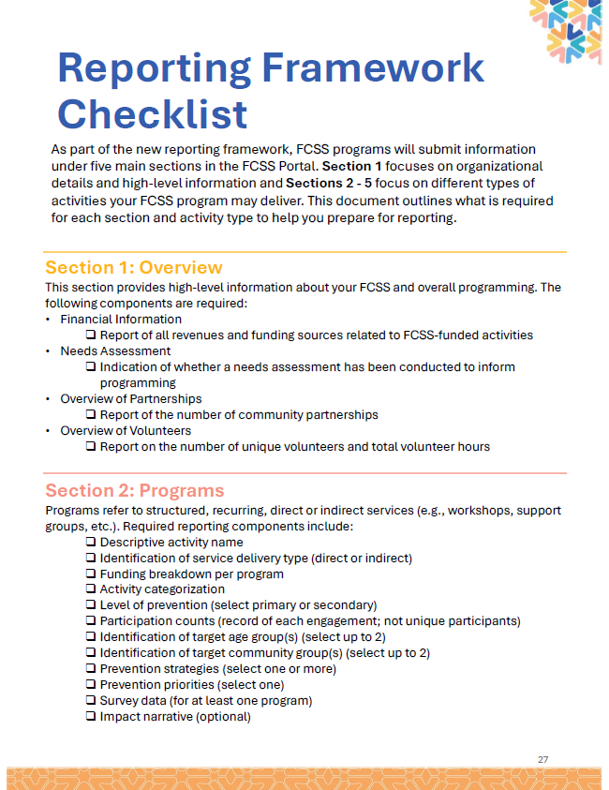
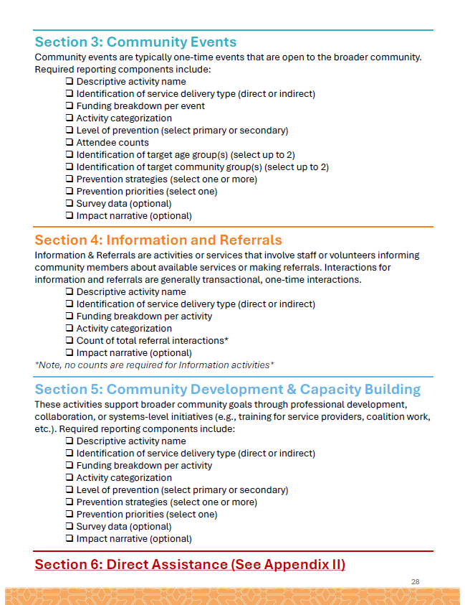
Reporting Framework Checklist
Training Resource
Training Package
Page 27 – 28, 53
Notes:
We have put together this checklist as a helpful resource based on the feedback we received from those who attended the early training sessions.
This checklist is located on pages 27 and 28 of the training package.
More information on direct assistance is located on page 53 of the training package.
This list highlights the key elements you will need to include in your updated annual report for each activity type.
This is a different way of presenting the same information from the chart we looked at earlier— as some folks might find this format a bit easier to understand and work with.

Slide 102






Next Steps & Key Milestones
Asynchronous Training Modules (fall 2025)
Updated Program Guide (fall/winter 2025)
FCSS Portal Training (summer/fall 2026)
First Time Reporting Using New Accountability Framework (January 2027)
Notes:
Before we clue up, let us discuss next steps and key milestones related to the accountability framework reporting.
These recorded, asynchronous modules will on-demand through the FCSS association of Alberta.
We are also working on an updated Program Guide. We are hoping to have that out to you by fall/winter 2025!
Additionally, we will be developing the updated FCSS online system over the winter of 2025/26 and into spring and summer 2026.
We are looking forward to offering you training on this updated FCSS portal by fall 2026.
Lastly, just a final reminder that the first-time reporting using the new Accountability Framework for your 2026 activities will kick off in January 2027 (for Metis Settlements, this is April 2027).

Slide 103

Thank you!
Notes:
Thank you for taking the time out of your schedule to participate in this training.
We have covered a lot of material throughout this training, and we want to close things by assuring you that you programs have already been doing many of these activities that collect the data needed for reporting.
You have already been doing things like using prevention strategies, without calling them that explicitly.
This reporting template is new…but with some familiar elements.
As we have touched on frequently, this reporting is about finding the best fit.
There is no perfect way to identify things like prevention priority, prevention strategies and activity categories.
Everything depends on the individual programs, their goals and community context.
If you have any questions at all, please reach out to the provincial FCSS team for assistance.
THANK YOU!

